Slide 1
2015 Senior Internship Recognition
Bellarmine School of Communication

Slide 2
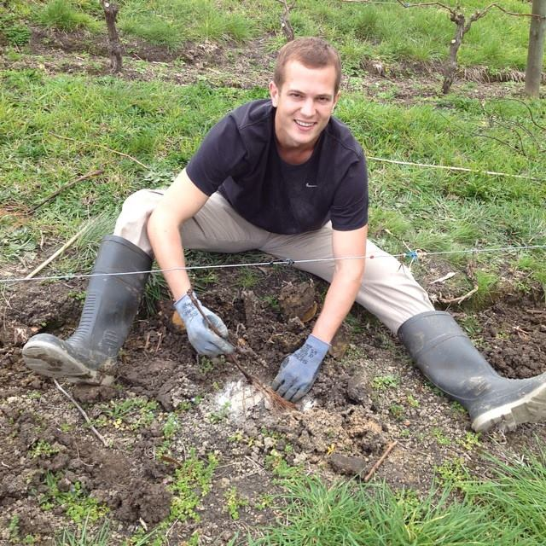
Connor Asay
Wine Making and Vineyard Management Intern at Stoneyridge Vineyard in Auckland, New Zealand

Slide 3
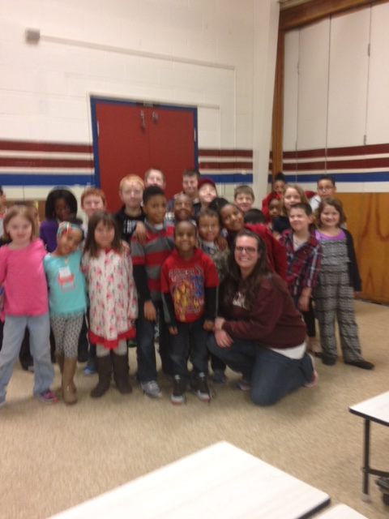
Sarah Barnes
Communication Intern at YMCA of Louisville

Slide 4
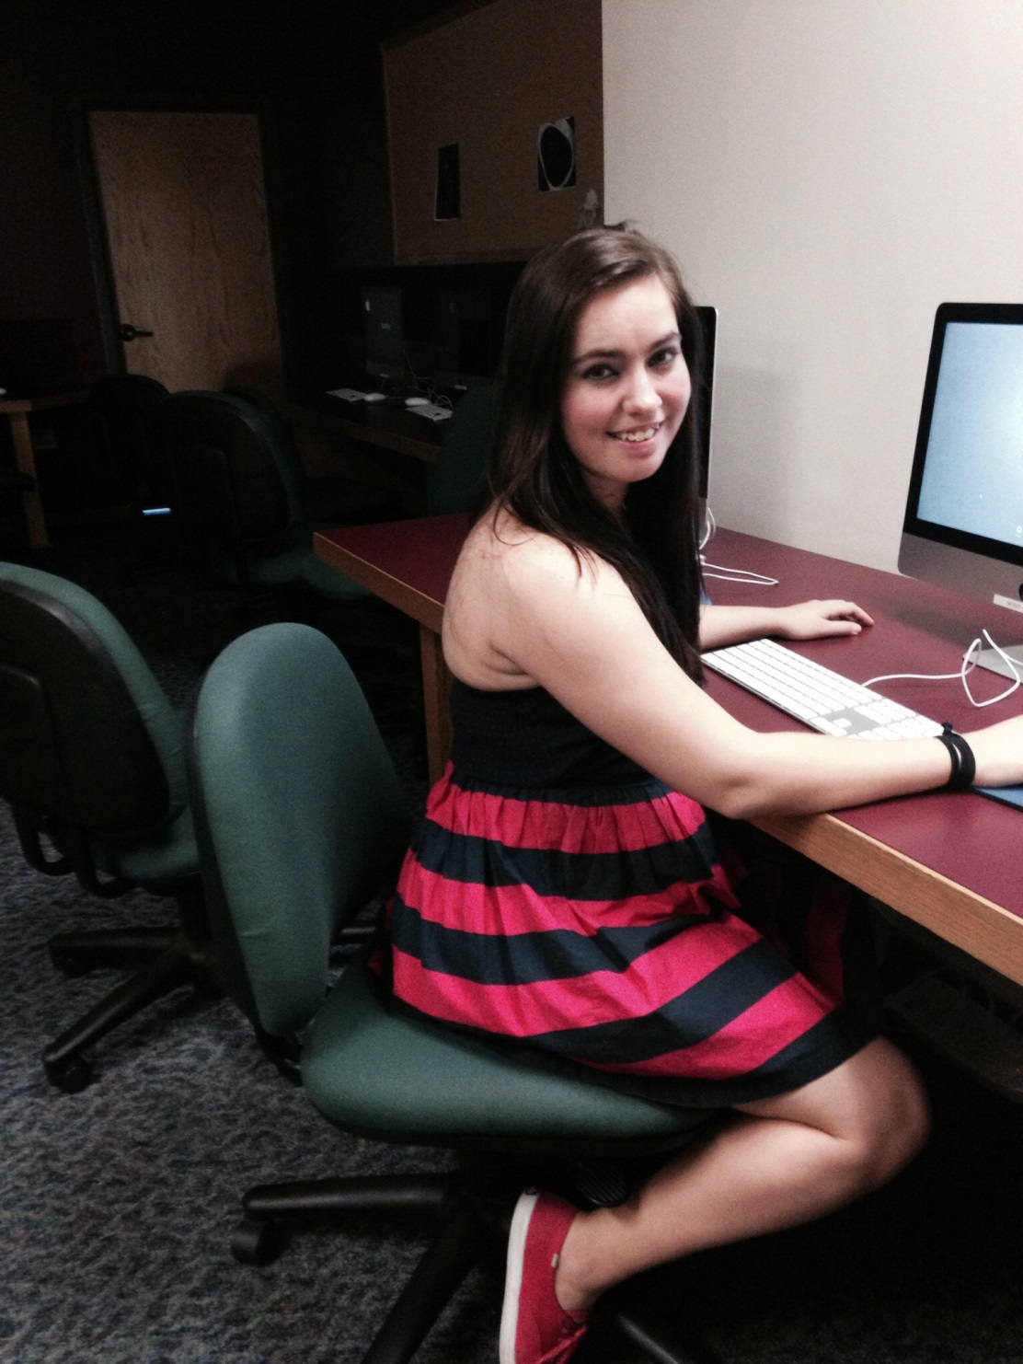
Heather CAmpbell
Communication Intern at Bellarmine’s Design, Arts, and Technology Department

Slide 5
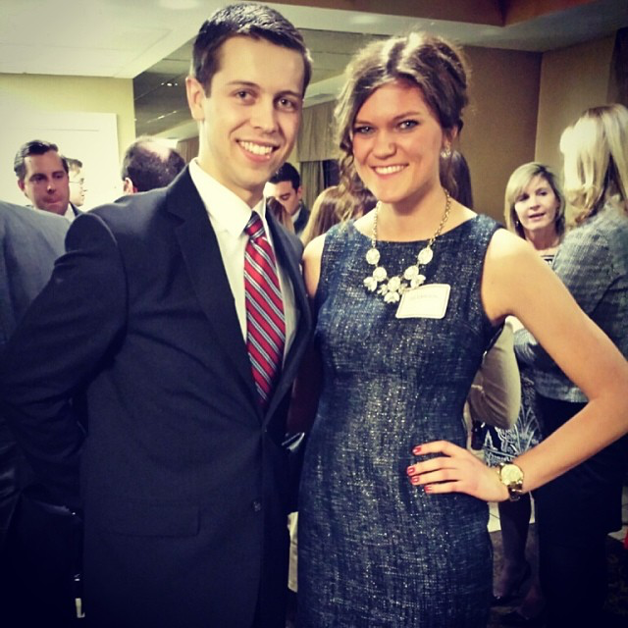
Elizabeth CArlson
Public Relations Intern at Republican Party of Kentucky

Slide 6
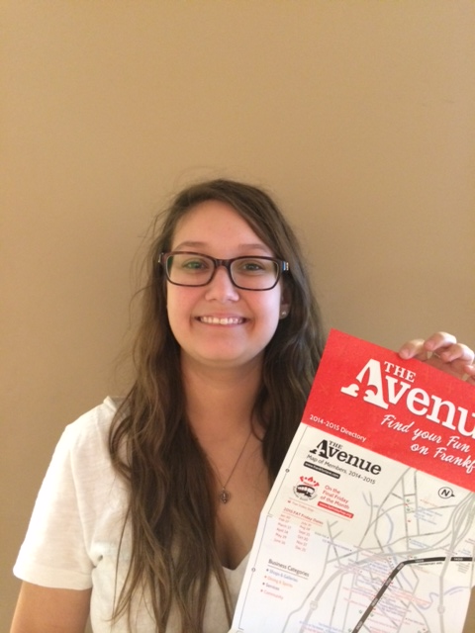
Monica Cunningham
-Social Media and Marketing Intern at Frankfort Avenue Business Association
-Events Coordinator Intern at RiverPark Place

Slide 7
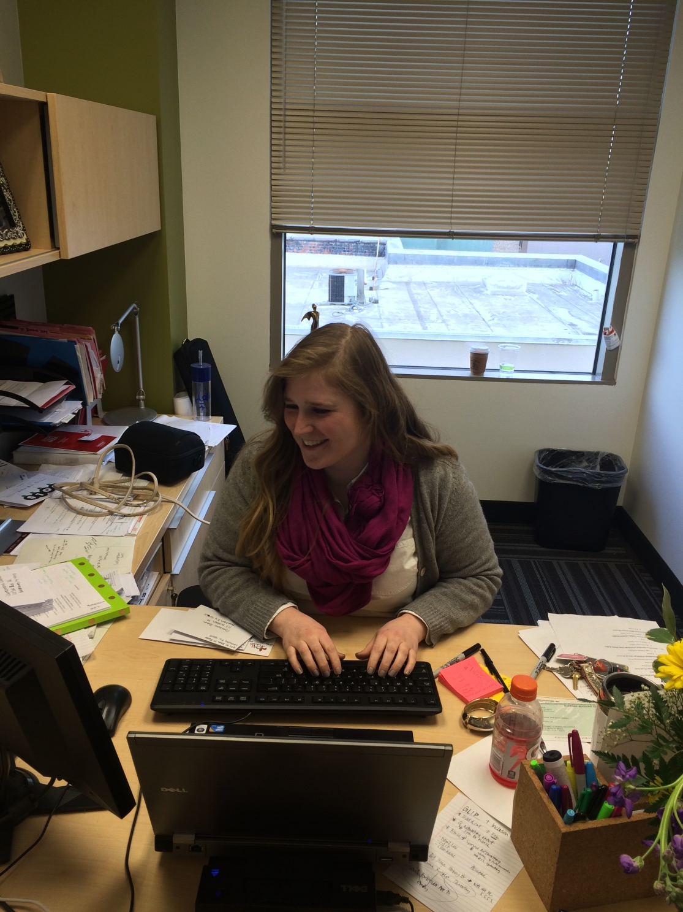
Dana Gramuglia
Communication Intern at Young Professionals Association of Louisville (YPAL)

Slide 8
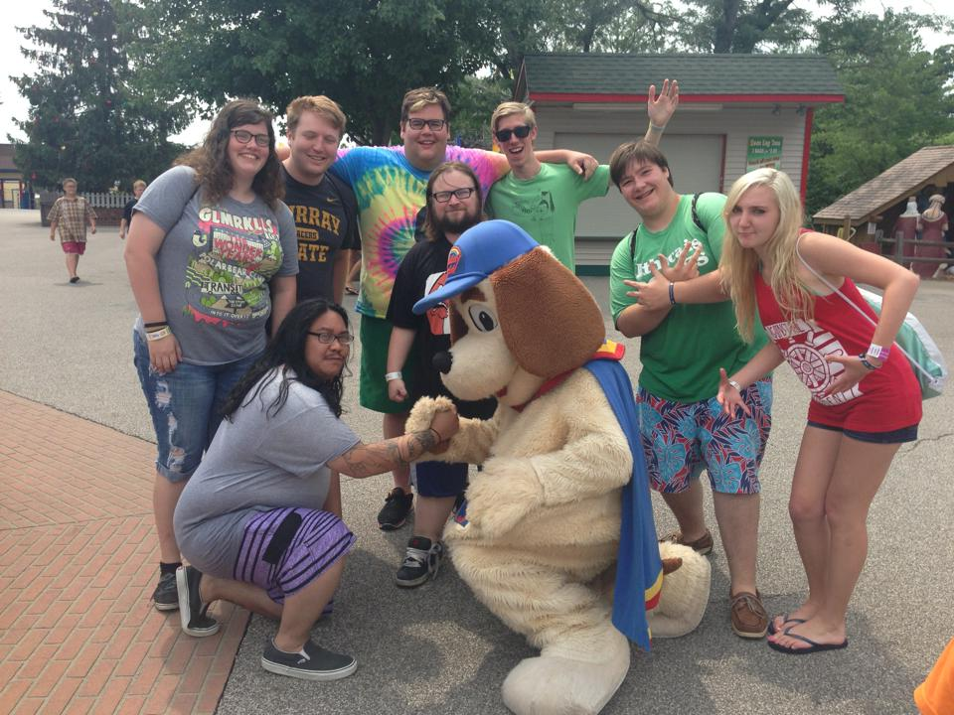
Christina Gutowski
-Graphic Design Intern at Little Heart Records
-Radio Intern at Clear Channel Radio
-Digital Marketing Intern at Louisville Bats Baseball

Slide 9
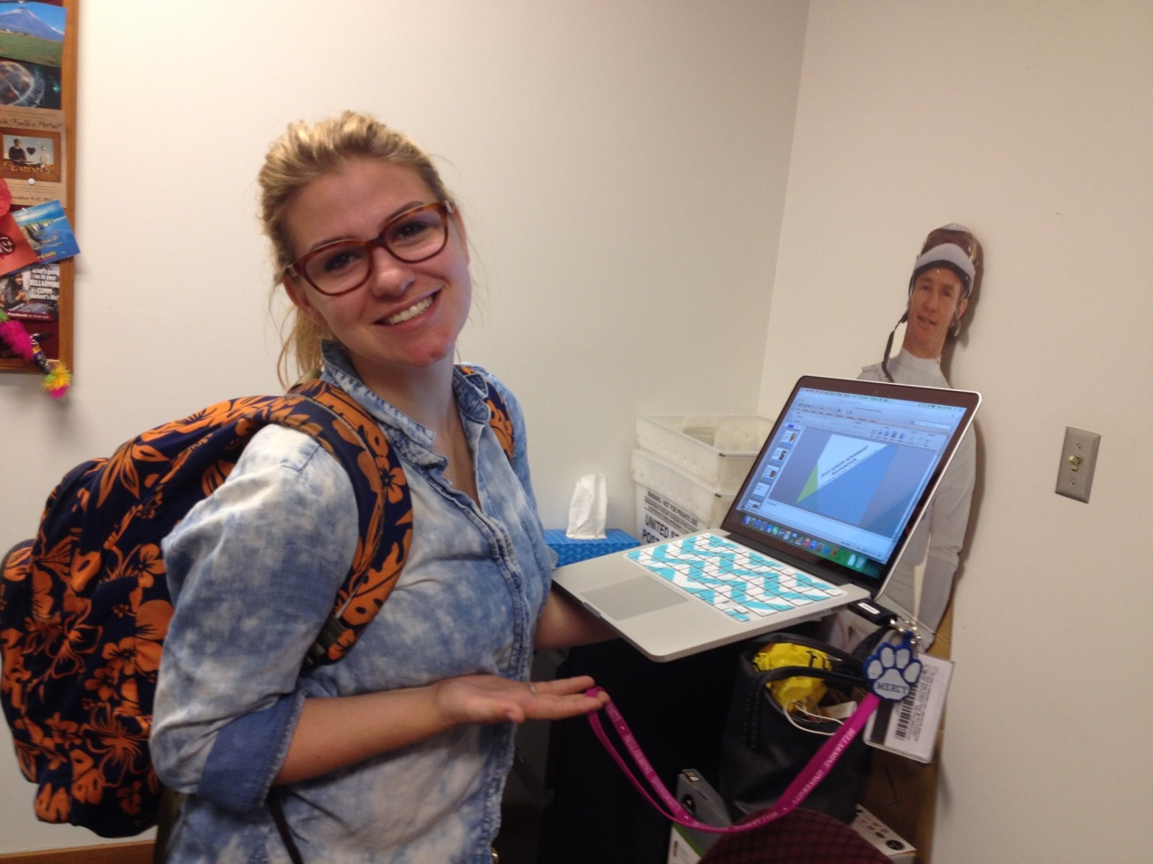
Abigail Holmes
Communication Intern at Creative Media Learning

Slide 10
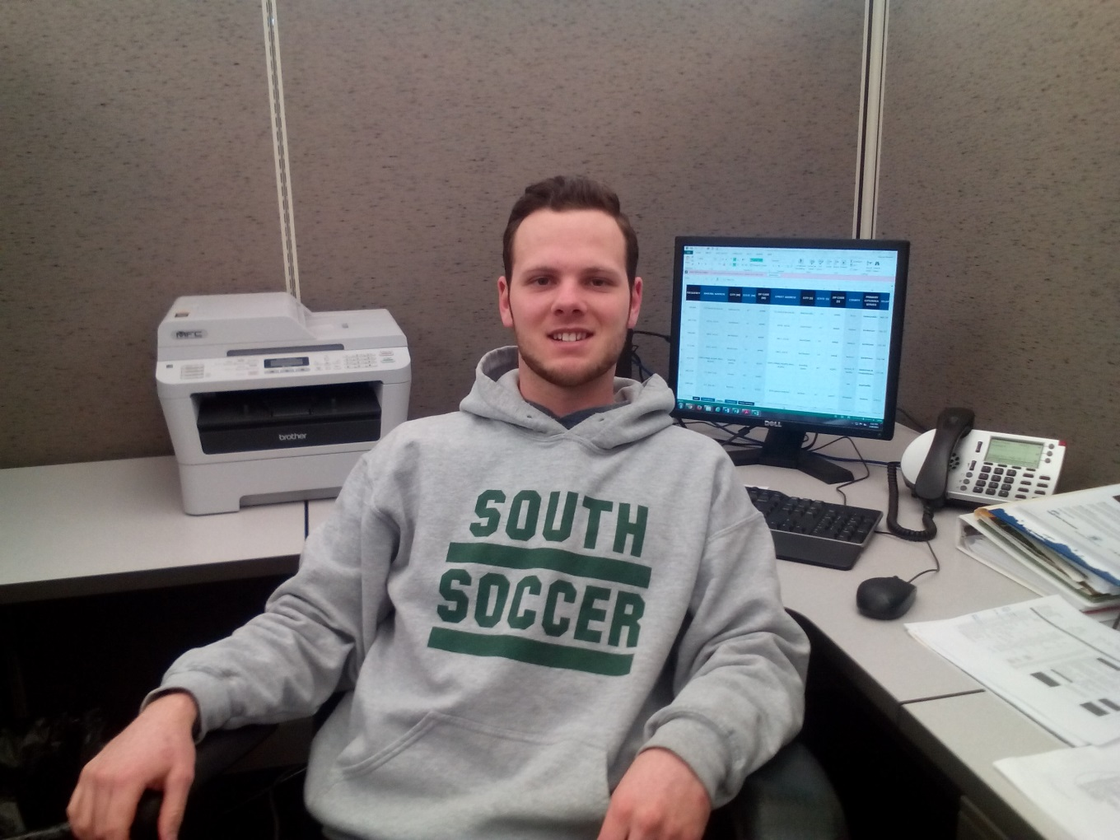
Brycen Howard
Communication Intern at Lincoln Heritage Council

Slide 11
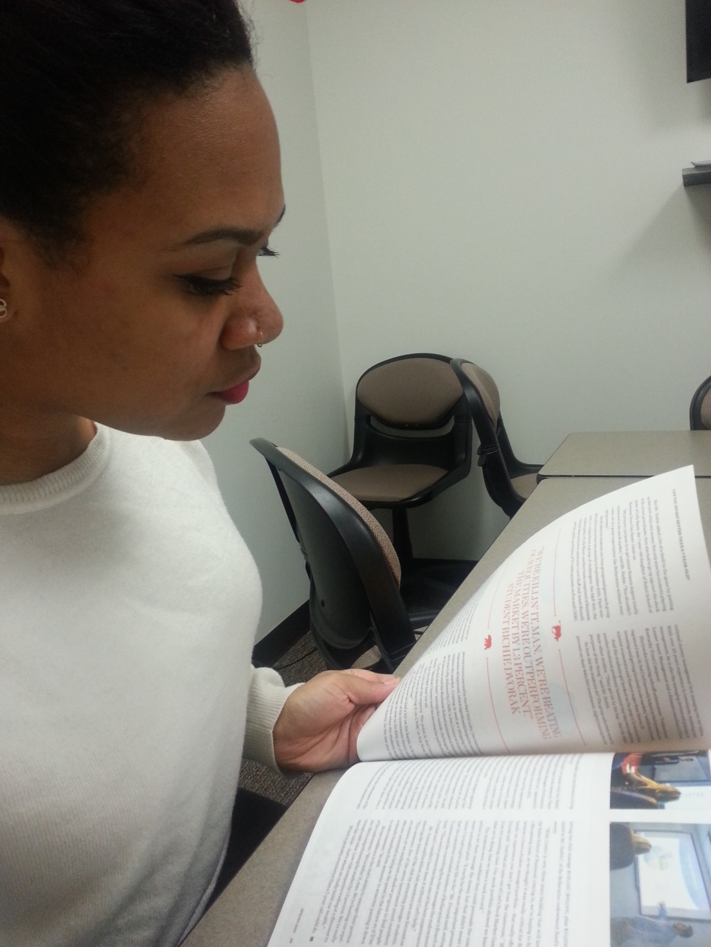
Kim Jackson
Communication Intern at Bellarmine’s Office of Communications and Public Affairs

Slide 12
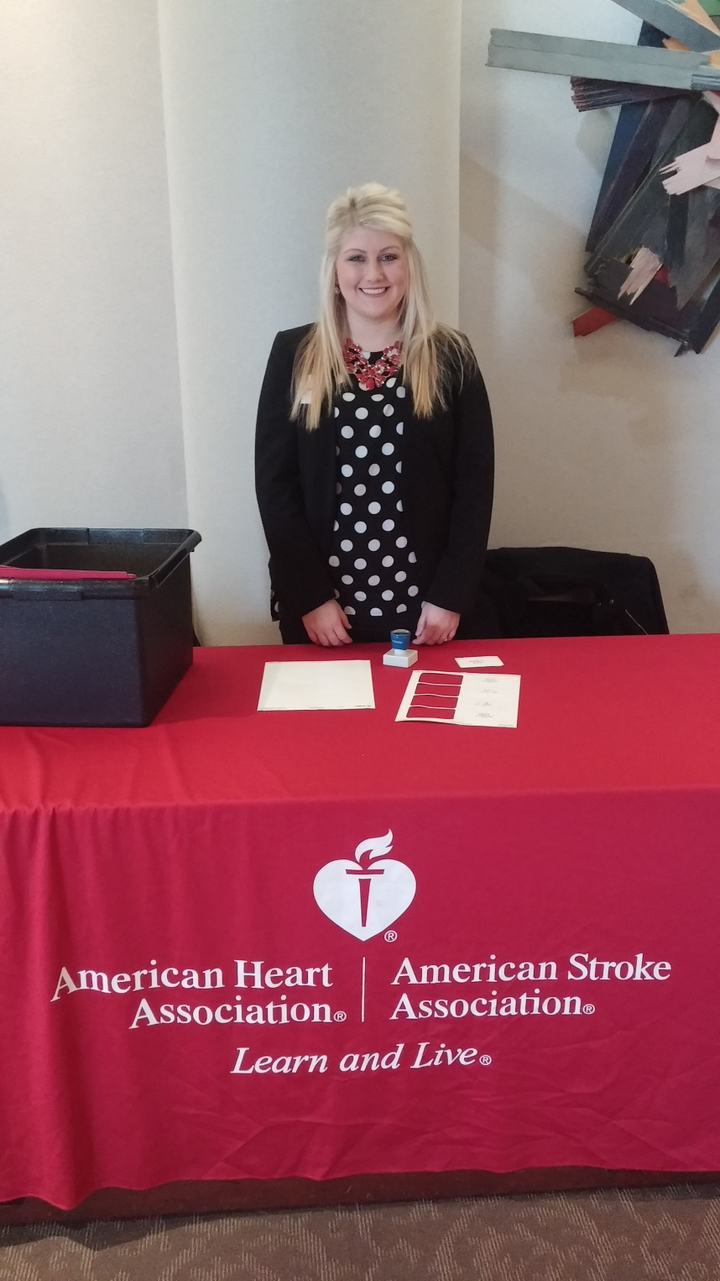
Whitney James
Heart Walk Team Intern at American Heart Association

Slide 13
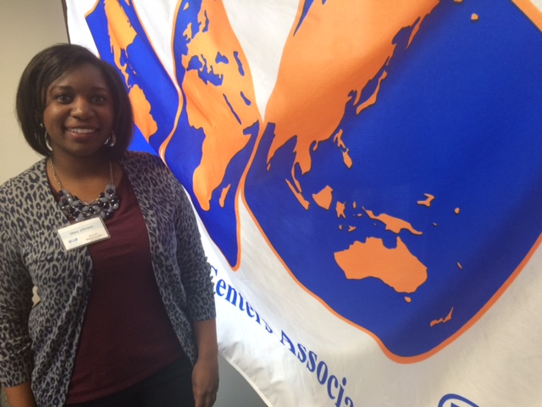
Mary Johnson
Marketing Intern at World Trade Center Kentucky

Slide 14
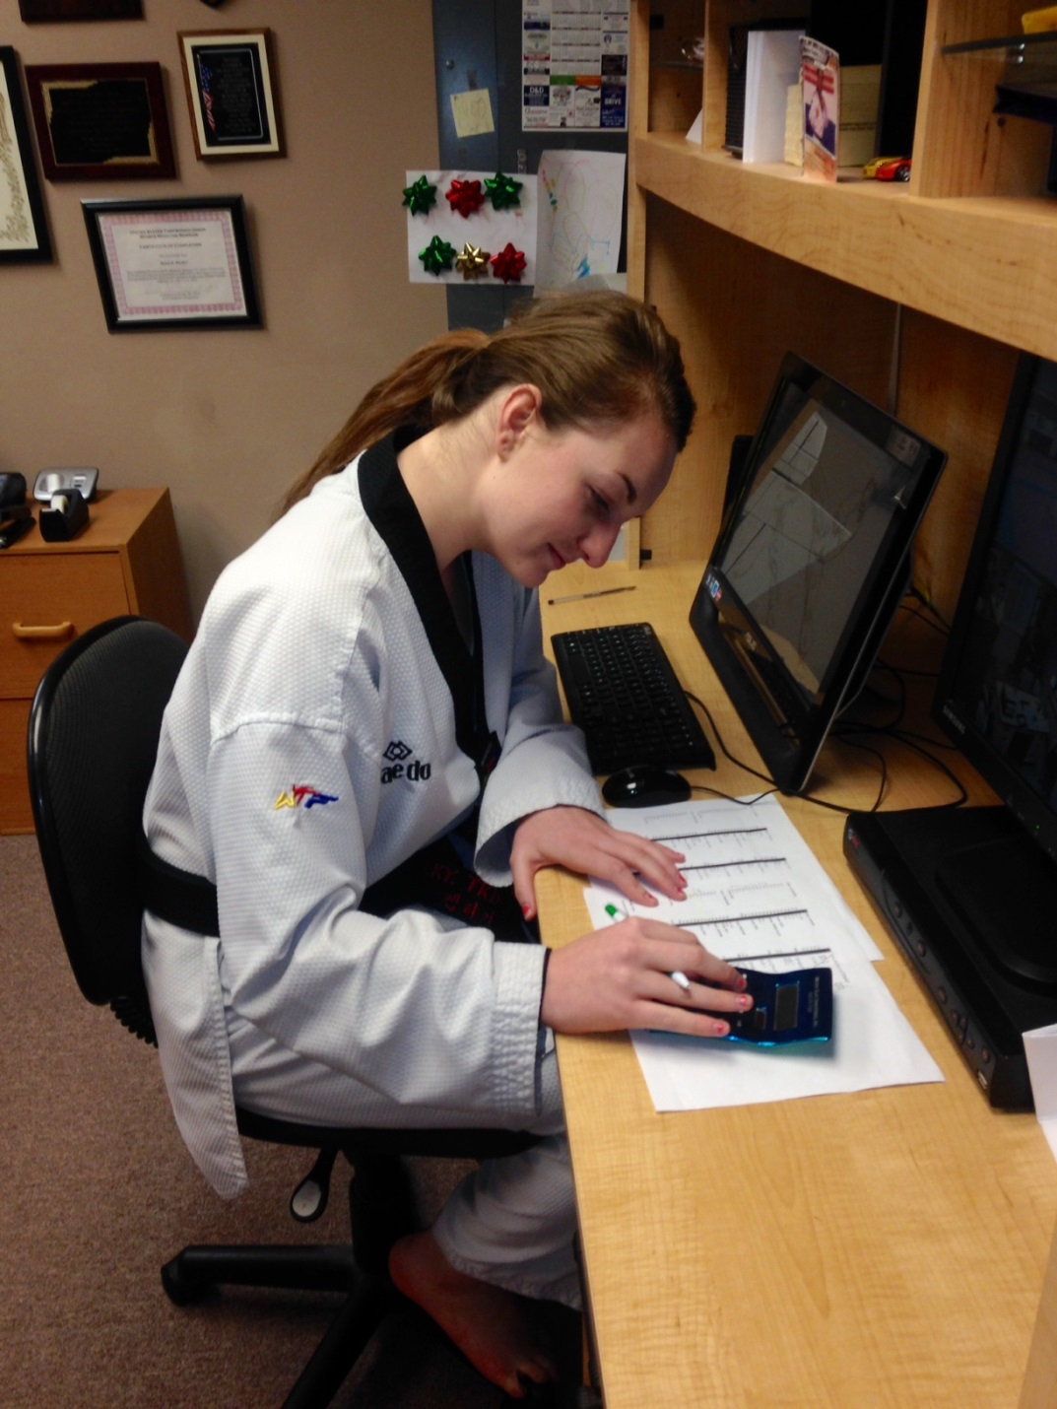
Lakin Louiso
-Public Relations and Marketing Intern at Louisville Sports Commission
-Communication Intern at Kentucky Tae Kwon Do & Fitness Academy, Inc.

Slide 15
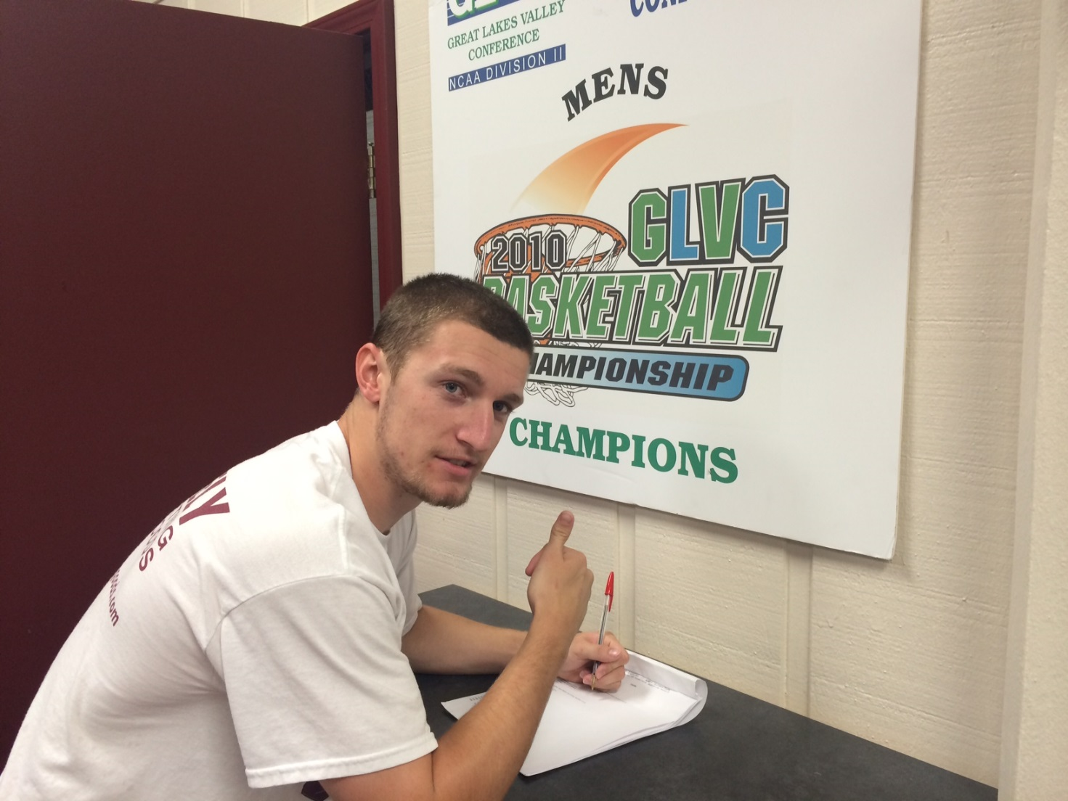
Corbin Maynard
Communication Intern at Bellarmine’s Basketball Camp

Slide 16
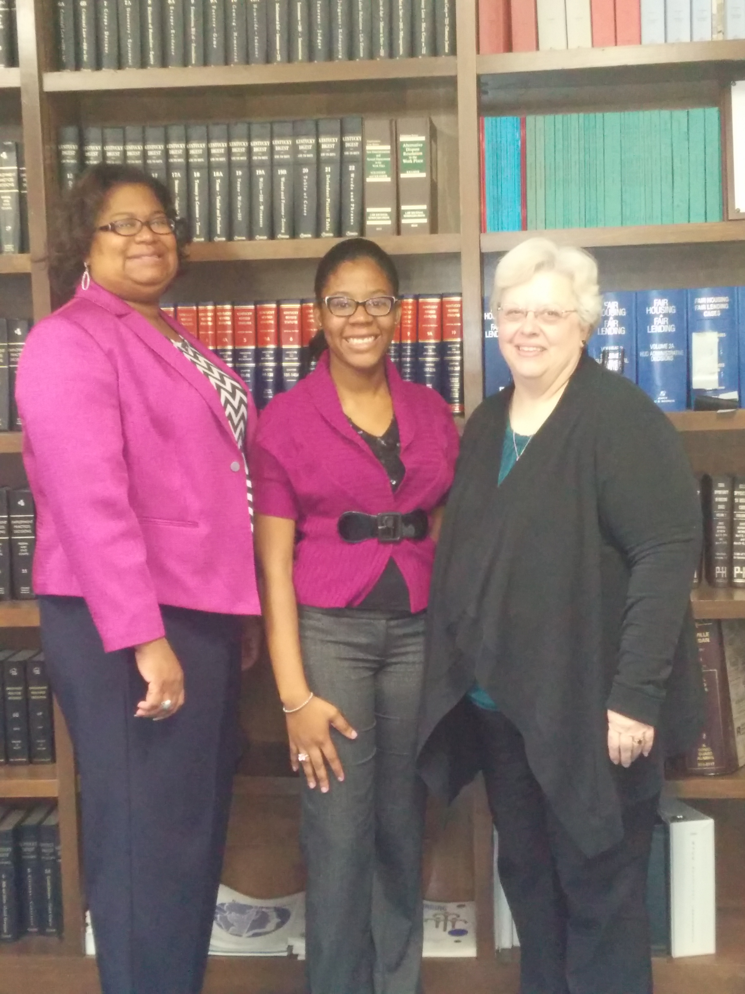
Ava Mitchell
Communication Intern at Louisville Metro Human Relations Commission

Slide 17
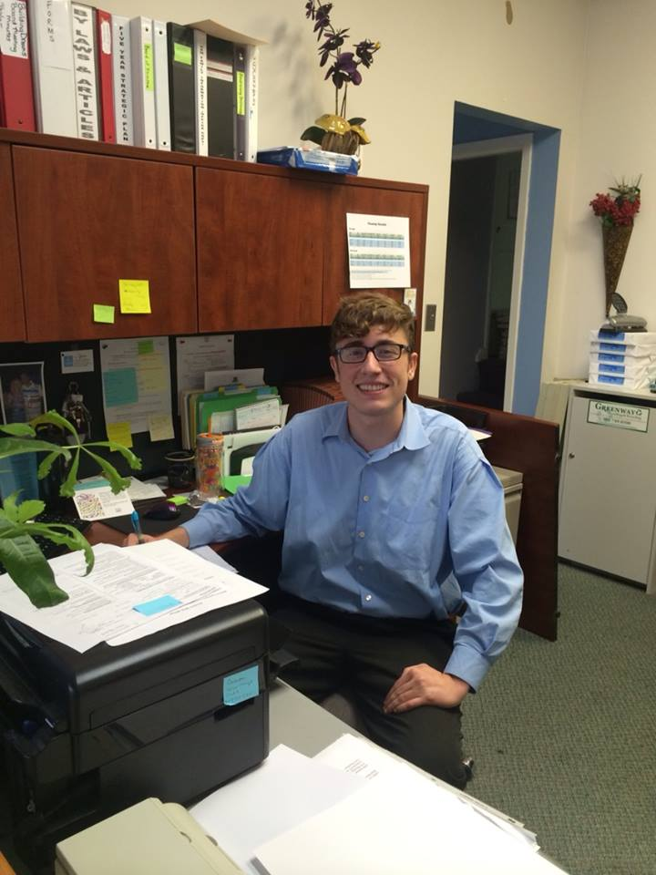
Dante Novario
Communication Intern at Dreams With Wings

Slide 18
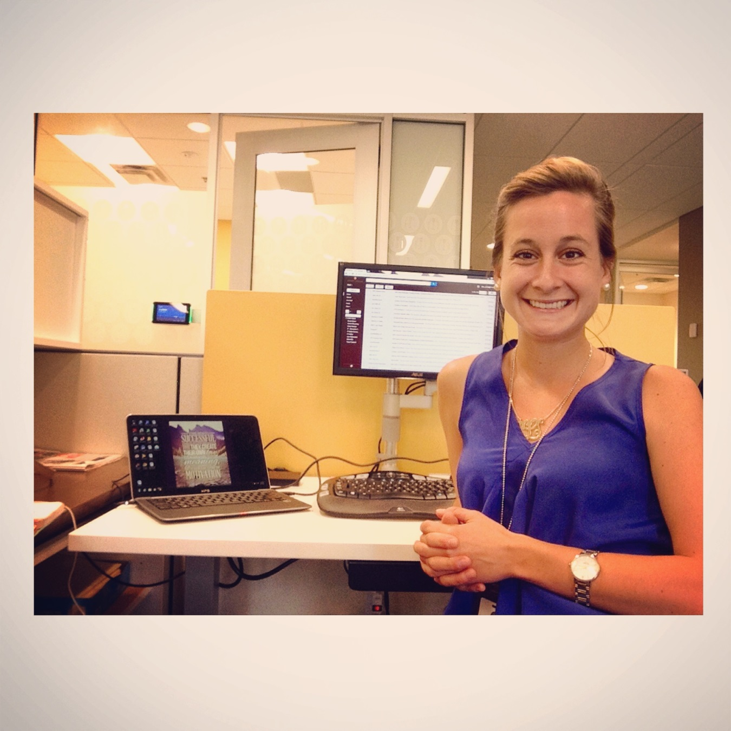
Alex Ojeda
Public Relations Intern at Brown-Forman Corporation

Slide 19
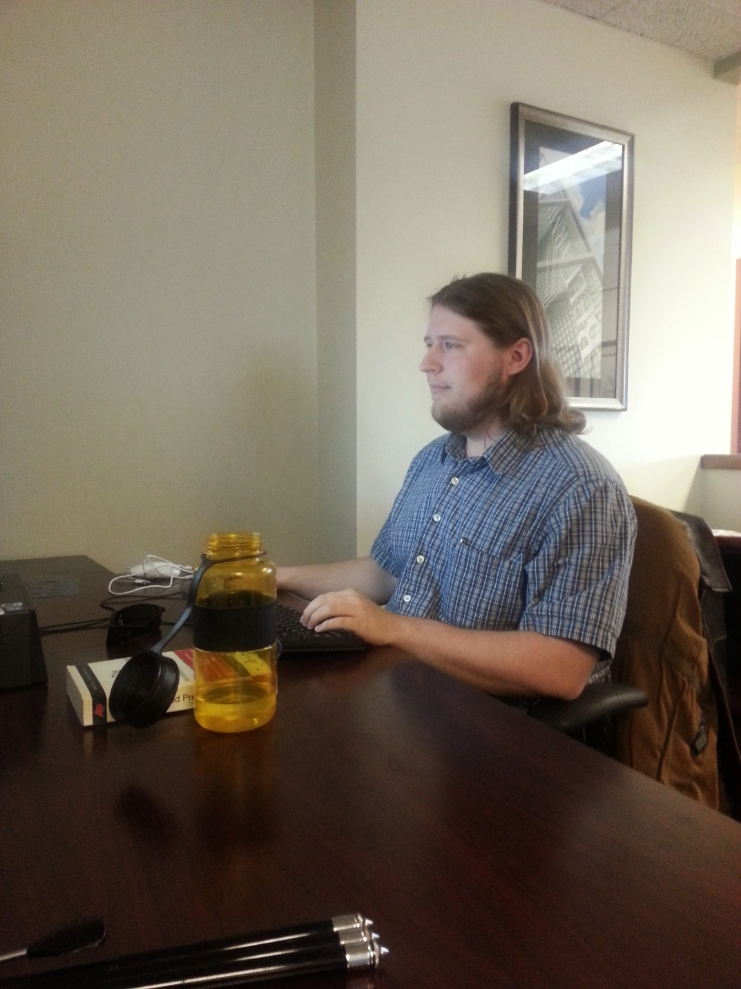
Walter Parker
Public Relations Intern at Bellarmine’s Office of Communications and Public Affairs

Slide 20
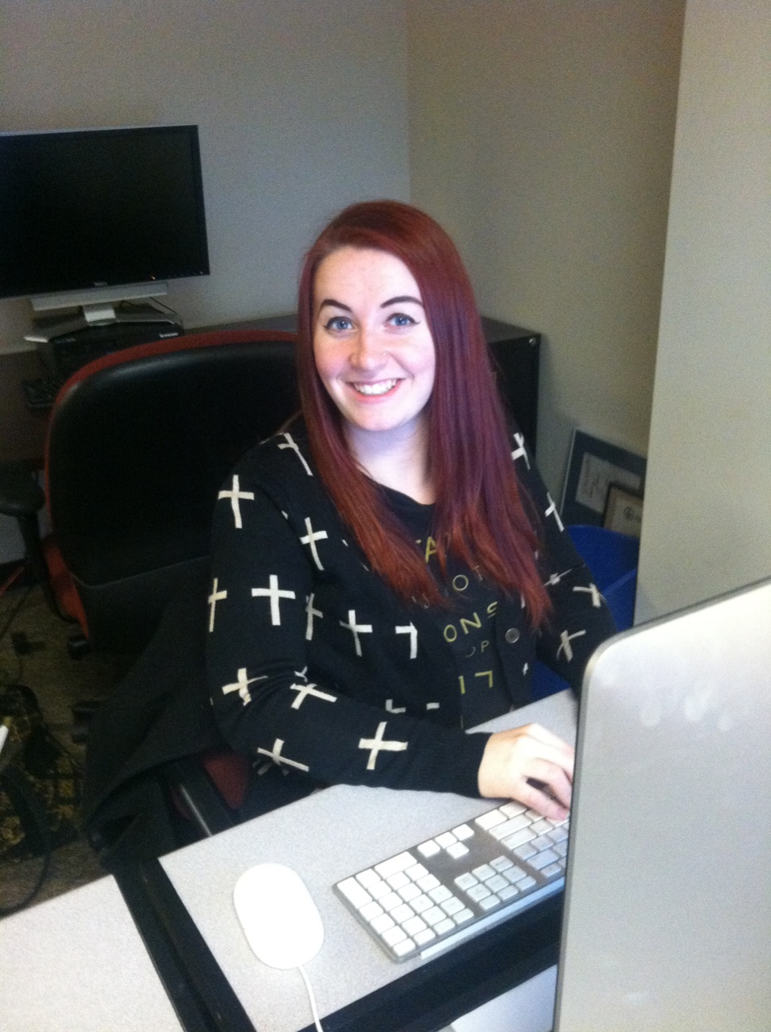
Ali Pfeiffer
Video Intern at Bellarmine’s Office of Communications and Public Affairs

Slide 21
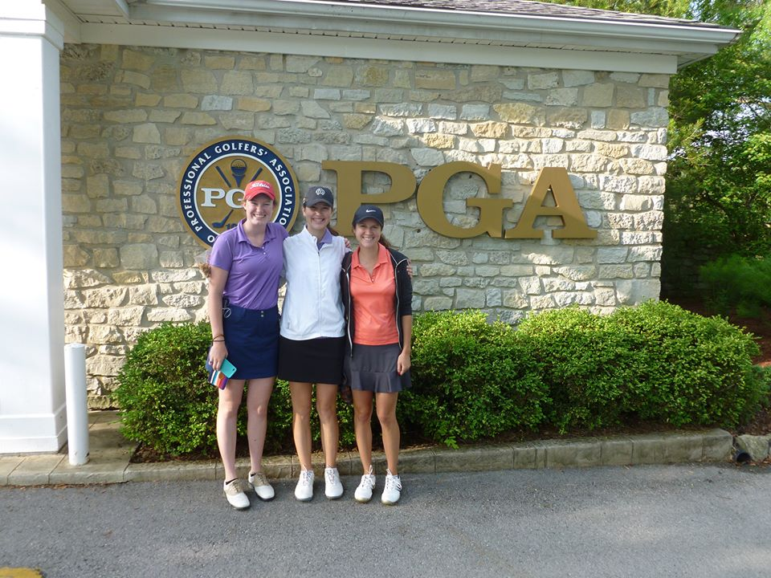
Angela Pugliano
Operations Assistant at PGA of America

Slide 22
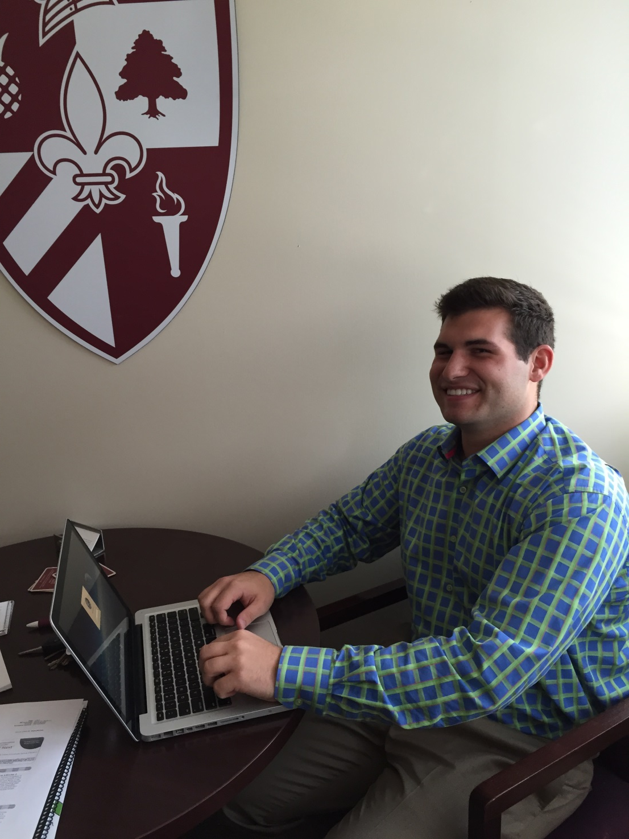
Nick Reinhart
Digital Signage Manager Intern at Bellarmine’s Office of Communications and Public Affairs

Slide 23
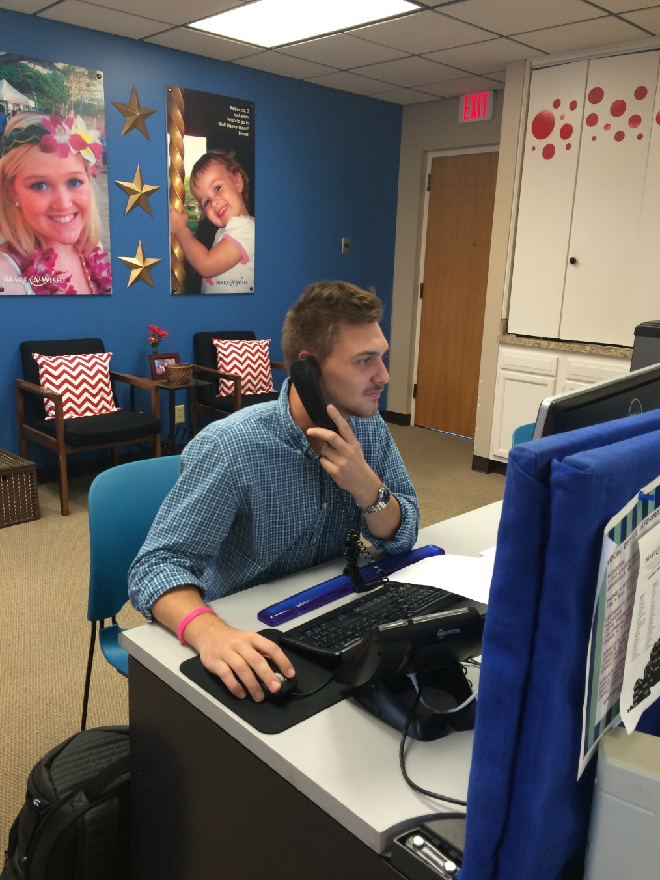
Zak Shankland
Development and Volunteer Services Intern at Make-A-Wish Foundation

Slide 24
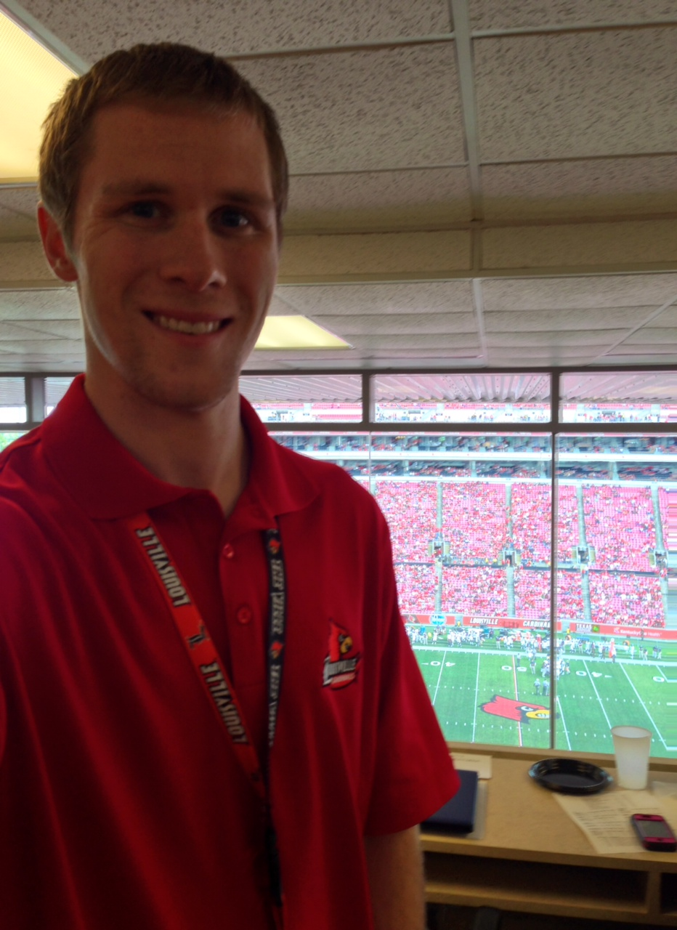
Jordon Smith
-Communication Intern at UL Sports Information
-Communication Intern at GameStop

Slide 25
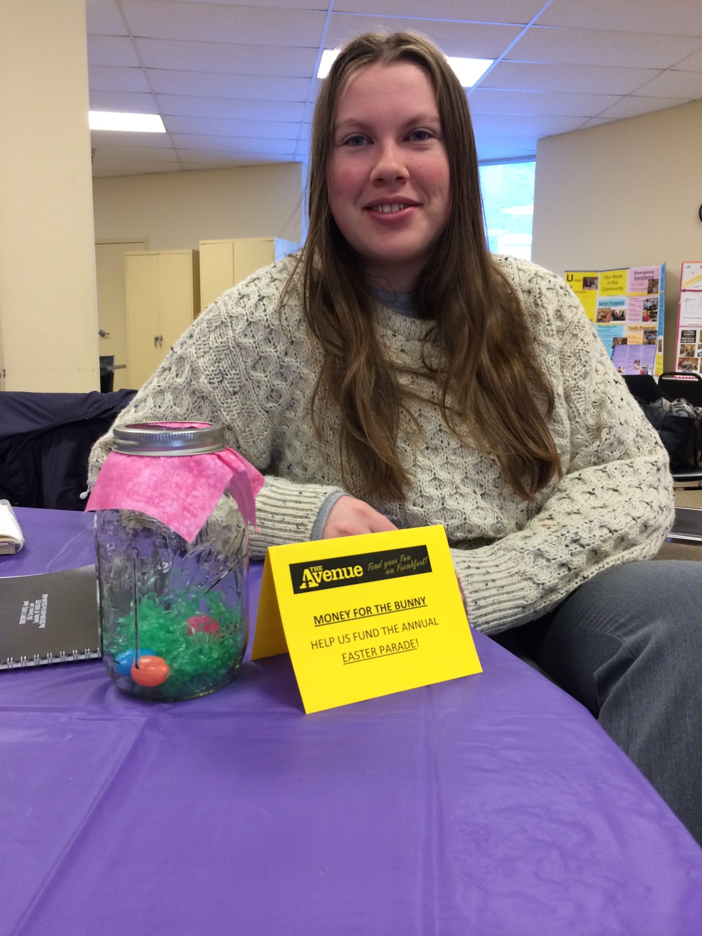
Kathryn Sullivan
Social Media & Marketing Intern at Frankfort Avenue Business Association

Slide 26
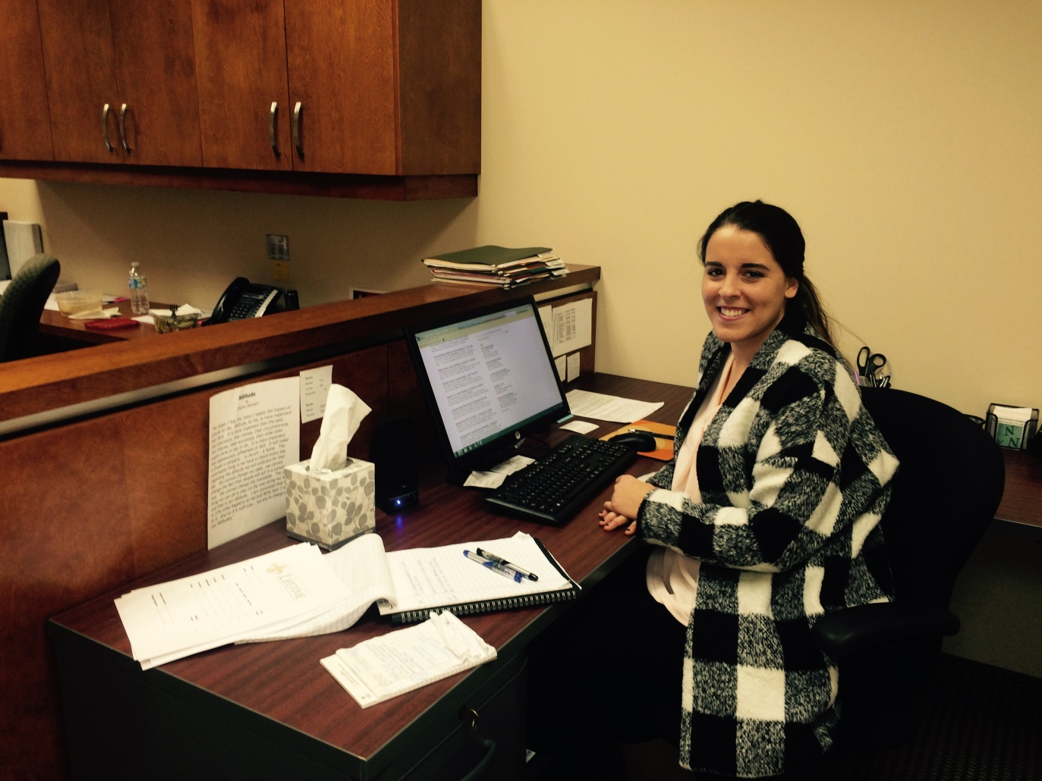
Hunter Teague
Communication Intern at Lifetime Financial Growth Company of Kentucky

Slide 27
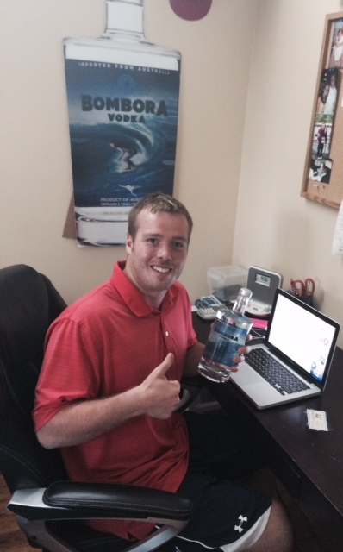
Reid Wesley
Sales Intern at Bombora Vodka Company

Slide 28
Heath Woolsey
Video Marketing Intern at Interapt LLC

