Slide 1
Title IX Advisor Training
September 2023

Slide 2
Today’s Goals
Role of an Advisor
Title IX Process
Resources for all parties
Navigating difficult outcomes
Resources for you

Slide 3
Role of an Advisor
Provide support and resources
Provide guidance
- understand the Title IX process
- know what the student or employee considers to be a favorable outcome
- understand their concerns and perspectives
Accompany the party to meetings
Helping parties sort through their thoughts through meaningful discussions
Reviewing investigative report and developing questions
Preparing the party for a Title IX conduct hearing
Ask questions on behalf of the party at the hearing
Assist in processing the outcome
Liaison with TIX Coordinator if necessary

Slide 4
Advisor Expectations
Support for the party
Knowledge of the Title IX process
Willingness and ability to communicate
Attendance at meetings if the party chooses
“Supportive Potted Plant” during investigation
Preparation of questions based on the investigation report
Cross-examination during the formal hearing
Respect for the process
Knowledge of resources

Slide 5
Developing Trust
Trustworthiness- being consistent, making tasks clear, maintaining appropriate boundaries
Collaboration- working alongside and sharing power
Empowerment- recognizing strengths, building skills that promote self-understanding and self-care
Cultural humility- finding great value in what we learn from others, being culturally relevant, honoring differences
Openness- Listen actively, give feedback respectfully, do not judge

Slide 6
Supportive Measures and Interim Measures
Why supportive and/or interim measures may be necessary:
- Provide safety
- Allow the parties to fully participate in and receive the benefits of academic programming throughout the process
- Access important resources
- Alleviate stress and anxiety resulting from the situation
- Demonstrate the university’s commitment to its values and compliance

Slide 7
Important Process Points
No Contact Directive
Formal & Informal Resolution
Violence Risk Assessment
Retaliation
Sharing Information
Saving Information
Interim Measures
Evidence Collection and Preservation
Preponderance of the Evidence
Additional Disclosures

Slide 8
Title IX Process
Address immediate safety concerns.
Provide resources, support, and reporting options to Complainant
Coordinator or Deputy Coordinator will conduct an inquiry
- Determination of risk
- Collection of available information
- Jurisdiction/Dismissal
Request for Formal Resolution / Receipt of Formal Complaint
Notice is given –
Advisors assigned /chosen & Investigators assigned
Dismissal
Determination
Investigation –
Draft Report Submitted
Hearing –
Responsibility & Sanctions Determined
Possible Appeal
Determination of Hearing &
Hearing Prep
Draft Report Reviewed & Follow up Completed –
Formal Report Submitted

Slide 9
Preparing for the Investigation and Hearing
Helping the party craft their statement
- Include a timeline of the event(s)
- Witnesses
- Ask thoughtful questions
- Specific details are helpful
- Evidence collection and preservation
Impact Conversation & Self-Care
- How do they need to be supported?
- What impact is this having on their university experience and life in general?

Slide 10
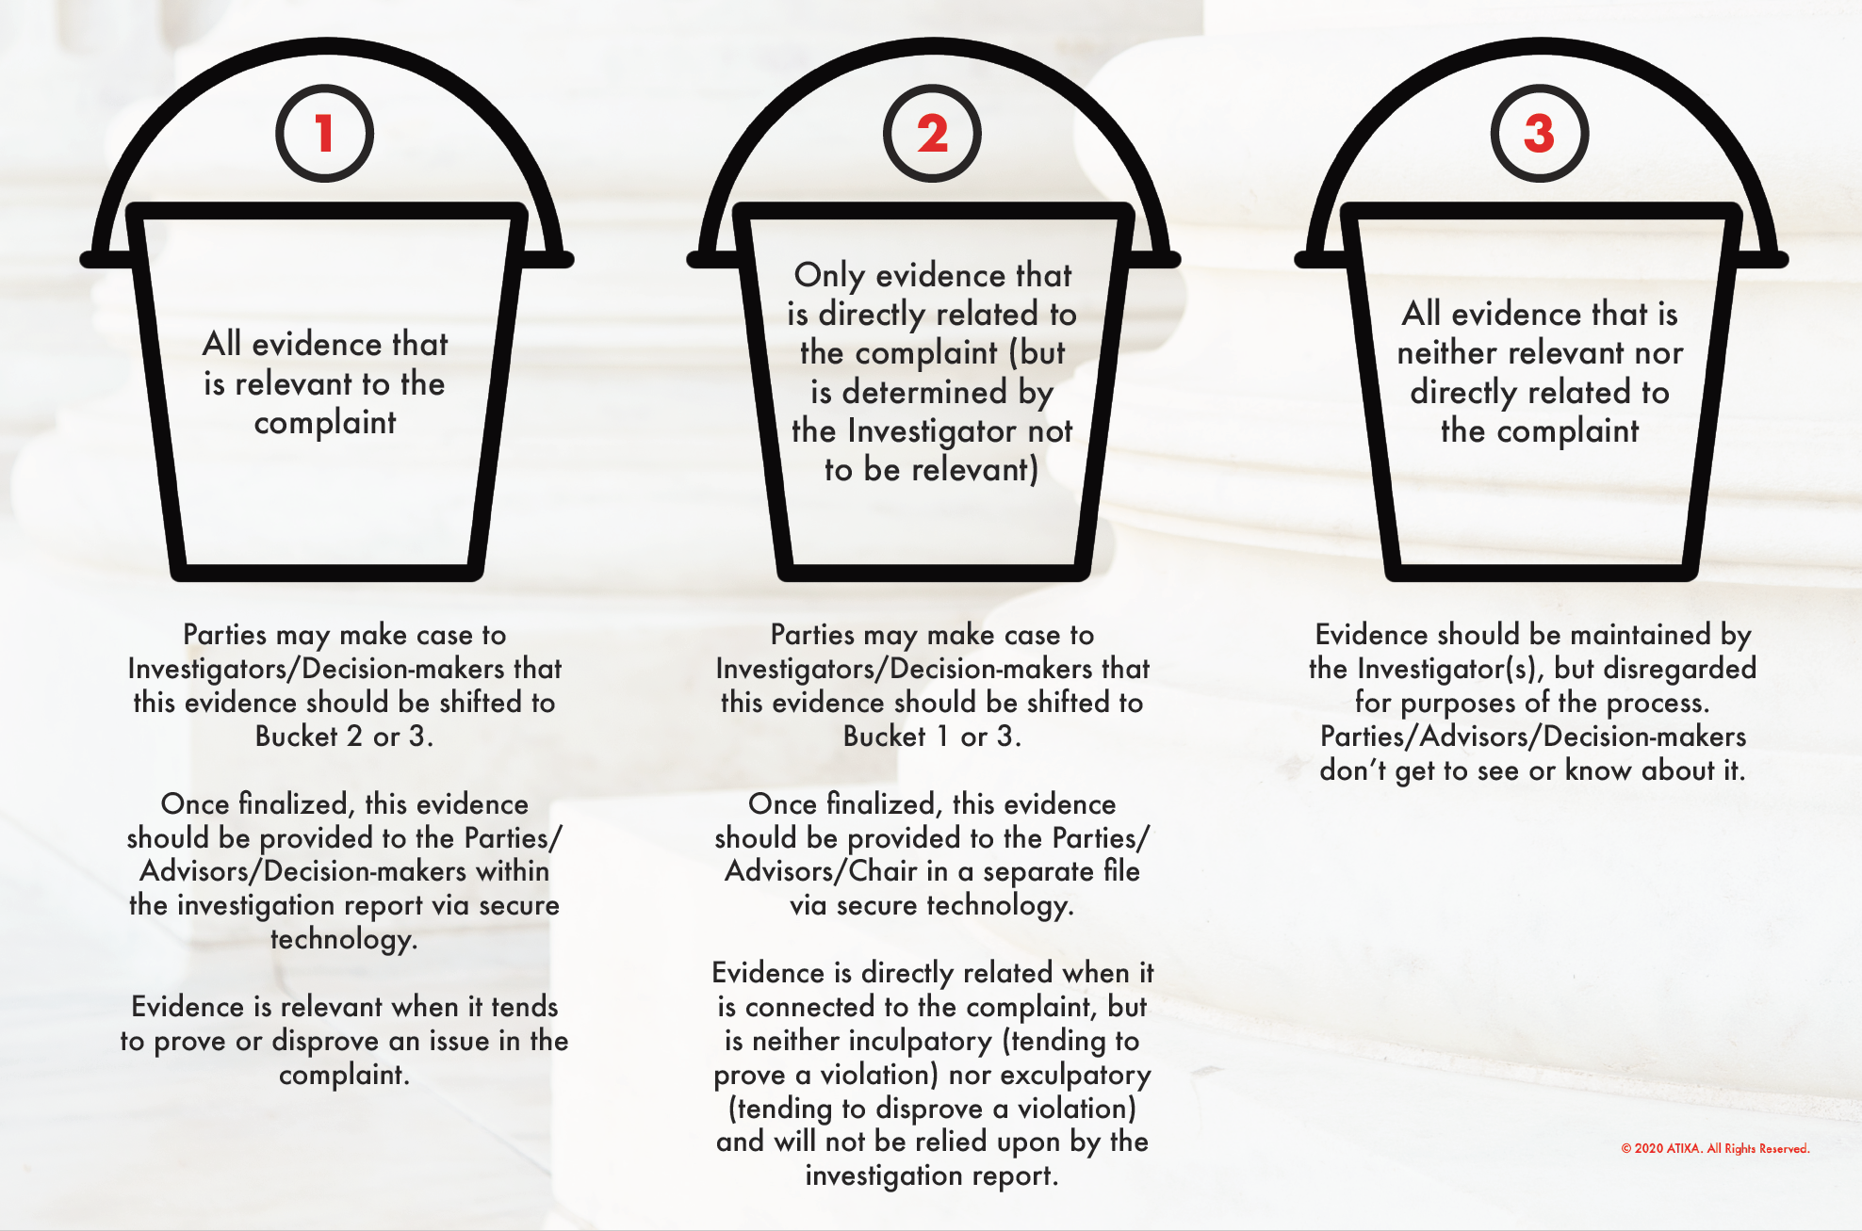
Buckets of Evidence

Slide 11
Credibility Assessment
Plausibility
Demeanor
Motive to Falsify
Corroboration
Past Record

Slide 12
Questions During the Process
4 Opportunities to gain clarity or ask questions
During the Investigation (through the party)
After review of the draft investigative report (to investigators)
Pre-hearing review with the Chief Hearing Officer
During the Hearing
Cross-Examination
Must be completed by the Advisor
Should not be questions already posed
Directed to the Chief Hearing Officer who has the right to dismiss questions or allow them
This is not a trial—it is not an opportunity to “outmaneuver the opponent.” It is an opportunity to learn more about what happened and if that is a violation of policy.

Slide 13
Processing Outcomes with the Party
Developing an outcome plan
- How will the party move forward after the hearing if x happens? If y happens?
- What resources and supports does the party have in place?
Plan to meet with the party after the outcome is delivered to process
- What support and resources do they now need?
- Do they want to appeal?
- Do they want additional check-ins?

Slide 14
Resources for Students
For processing:
- BU Counseling Center - Center for Women and Families
- BraveBU
- Campus Ministry
For health-related concerns:
- BU Health Services
- Any local emergency room
- Center for Women and Families
For Campus Support and Safety:
- Title IX Office
- Public Safety
- Residence Life
For additional safety measures and court orders– Louisville Metro Police Department, Special Victims Unit; Jefferson County District Court
Encourage self-care

Slide 15
Resources for Employees
Counseling through EAP
Center for Women and Families
Title IX Coordinator / Deputy Coordinators Potential Interim Measures through BU
Court Orders
Encouraging Self-Care Strategies

Slide 16
Resources for Advisors
Trauma-Informed Guide
Advisor Expectation Agreement
Advisor Guide to the Process
Advisor Checklist in Preparation for Hearing

Slide 17
Questions?

