Slide 1
Title IX Hearing Officer (Decision Maker) Training
September 2023

Slide 2
Today’s Goals
Role of Hearing Officer
Overview of Title IX Process
Hearing Process
Guidance on Questioning
Evidence Review & Preponderance of the Evidence
Credibility Assessment
Groupthink & Bias
Determination & Rationale

Slide 3
Role of Hearing Officer
Remain impartial
Understand the policy
Review all information available
Develop questions for greater understanding
Engage in open discussions with colleagues
Weigh the evidence & assess credibility
Determine findings & recommend sanctions

Slide 4
Title IX Process
Address immediate safety concerns
Provide resources, support and reporting options to complainant
Inquiry is conducted
  Collection of available information
  Determination of risk
  Jurisdiction / Dismissal
Request for Formal Resolution / Receipt of Formal Report
Notice is given –
Advisors assigned /chosen & Investigators assigned
Dismissal
Determination
Investigation –
Draft Report Submitted
Hearing –
Responsibility & Sanctions Determined
Possible Appeal
Determination of Hearing &
Hearing Prep
Draft Report Reviewed & Follow up Completed –
Formal Report Submitted

Slide 5
Hearing Process
Scripted Hearing
Introduction of people, summary of case
Questions to investigation team
Review of documents (as necessary)
Questions to parties / witnesses
Cross examination
Final statements
Determination of Hearing Panel
Findings
Sanctions
Rationale for all decisions

Slide 6
Developing Questions
Review the Investigation Report thoroughly
Review implicated policies and definitions
Outline the elements of the definition
Do you have evidence regarding each element?
What other information would be useful to know regarding each element?
Trauma-informed questioning

Slide 7
Questions from the Parties
Allowable Questions
Those not already posed to investigators or answered in the report or prehearing meeting
Should not contain overarching character questions
Should not be badgering or harassing in nature
Cross Examination of the Parties
Must be completed by Advisor, should not be questions already posed
Directed to the Chief Hearing Officer who has the right to dismiss questions or allow them.

Slide 8
Credibility Assessment
Plausibility
Demeanor
Motive to Falsify
Corroboration
Past Record

Slide 9
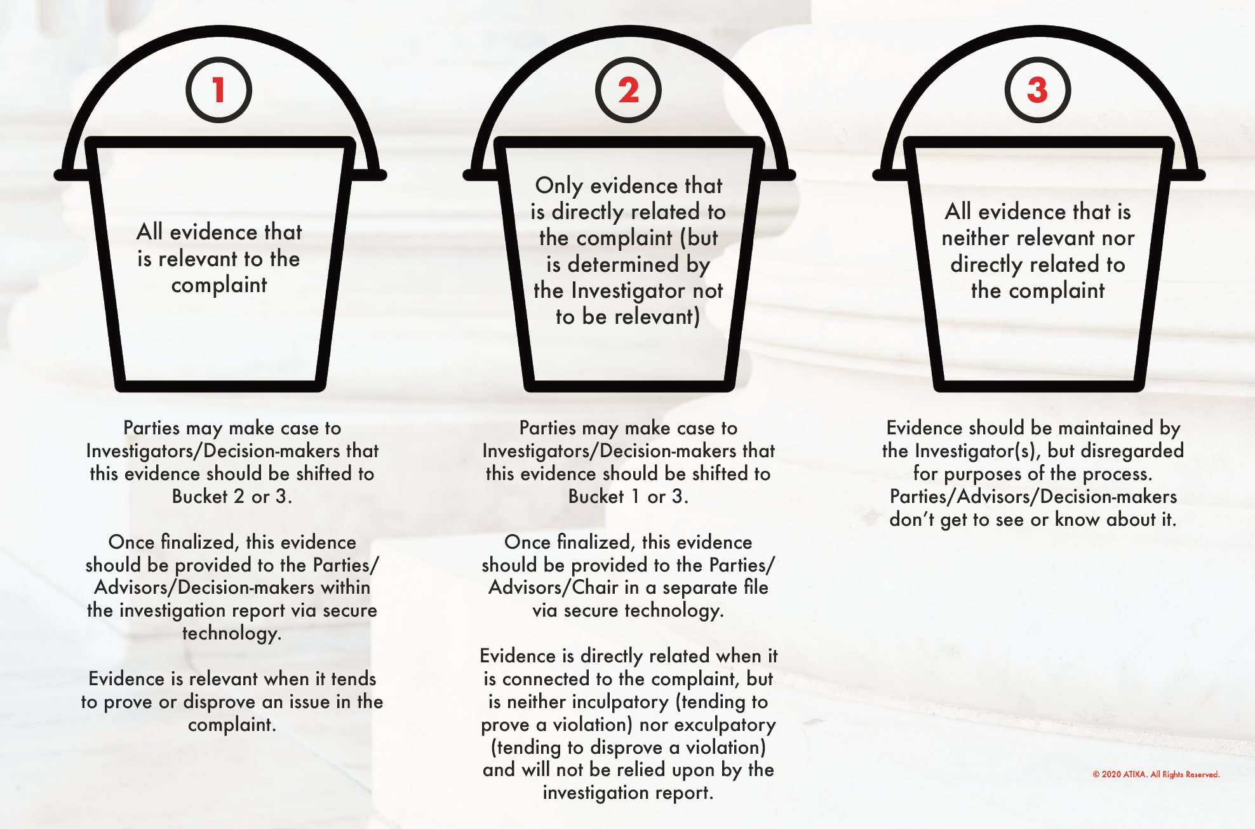
Buckets of Evidence

Slide 10
Preponderance of the Evidence
More likely than not that consent was not present
More likely than not that incapacitation was at play
More likely than not that the action/behavior took place
50% plus a feather

Slide 11
Acknowledging and Challenging Implicit Bias
Stereotypes
Confirmation bias
Personal experiences
Approach with objectivity
Listen actively, impartially, and openly
Acknowledge when you cannot be impartial

Slide 12
Group Think
- Tendency to avoid discomfort that comes from disagreement
- Engage in meaningful and respectful dialogue with colleagues
- Decisions are based on majority
- Dissent is welcome

Slide 13
Providing Rationale
Must be provided for all decisions
What evidence was determined relevant/irrelevant
Consent & Incapacitation Determination
Credibility Assessment
Policy Findings
Recommendation of Outcomes / Sanctions

Slide 14
Resources for You
Trauma-Informed Guide
Decision Maker Guide to the Process
Credibility Assessment Checklist
Decision Maker Checklist in Preparation for Hearing
Script & Procedural Roadmap

Slide 15

Self-Care

Slide 16
Questions?

