Slide 1
Title IX Investigator Training
September 2023

Slide 2
Goals for Today
Foundations of Title IX
Role of an Investigator
Title IX Process
Conducting an Investigation

Slide 3
Foundation of Title IX
Title IX of the Education Amendments of 1972 is a federal law intended to end sex discrimination in all areas of education
  Applies to non-discrimination based on sex/gender to all recipients of federal funds
  Applies to issues of program equity, sexual harassment and sexual assault
  2011 Dear Colleague Letter
  2020 Regulations
  2022 – Proposed Rule Making in progress

Slide 4
Definitions
Sexual Misconduct
Sexual Assault
Sexual Harassment
Sexual Exploitation
Stalking
Dating Violence
Domestic Violence
Incapacitation
Retaliation

Slide 5
Consent
Consent is clear, knowing and voluntary.
Consent is informed, freely given through mutually understandable words or actions.
Consent is active, not passive.
The responsibility to obtain consent rests with the initiator of the activity.
Consent can be withdrawn.
Consent to one activity is not consent to another.
The fact that consent was given in the past does not mean consent is given now.

Slide 6
Title IX Process
Address immediate safety concerns
Provide resources, support, and reporting options to survivor
Coordinator or Deputy Coordinator will conduct an inquiry
  Determination of risk
  Collection of available information
  Jurisdiction Assessment
Student wishes to file a formal report
Notice is given – Investigators are assigned. Advisors are provided.
Jurisdiction Assessment
Hearing - Determination of Responsibility & Sanctions
Completed Investigation – Determination of Hearing
Possible Appeal

Slide 7
Rights of Both Parties
Each party may have up to 2 advisors of their choice
Interim measures and support
Notice of all processes including rationale for decisions
Participation in an informal or formal process
- Both parties must agree to informal resolution
- Informal resolution is not an option in cases where the Respondent is an employee and the Complainant is a student
Access to investigation report

Slide 8
Coordinator Role
Coordinating support and interim measures
Connecting parties to resources
Receive initial reports and make initial determinations
Coordinate the investigative process:
- Draft and send initial notice to parties
- Assign investigators
- Consult on the case
- Reach out to parties and assist with scheduling as needed
Review final investigation report and make determination
Oversee hearing and appeals process

Slide 9
Role of Investigator
General
- Knowledge of the process
- Impartial fact finder
Pre-Interview
- Review all documentation or other evidence provided
- Develop investigation strategy and questions
Interviews
- Gather as much relevant information as possible
- Ask substantive and specific questions
- Create summary reports for each interview
- Document all outreach & meetings
Submit Final Investigation Report
- Include determinations related to evidence, witnesses, and credibility
- Include all materials and interviews
- Indicate facts of the case and discrepancies

Slide 10
Acknowledging and Challenging Implicit Bias
Stereotypes
Confirmation bias
Personal experiences
Approach with objectivity
Listen actively, impartially, and openly
Acknowledge when you cannot be impartial

Slide 11
Developing Effective and Relevant Questions
Relationship of parties
Context of interaction or event
Time and place
People involved / witnesses
Overall impact
Following up on other evidence
- What does it tend to prove or disprove?
- Does it provide context?
- Does it corroborate a party’s story?

Slide 12
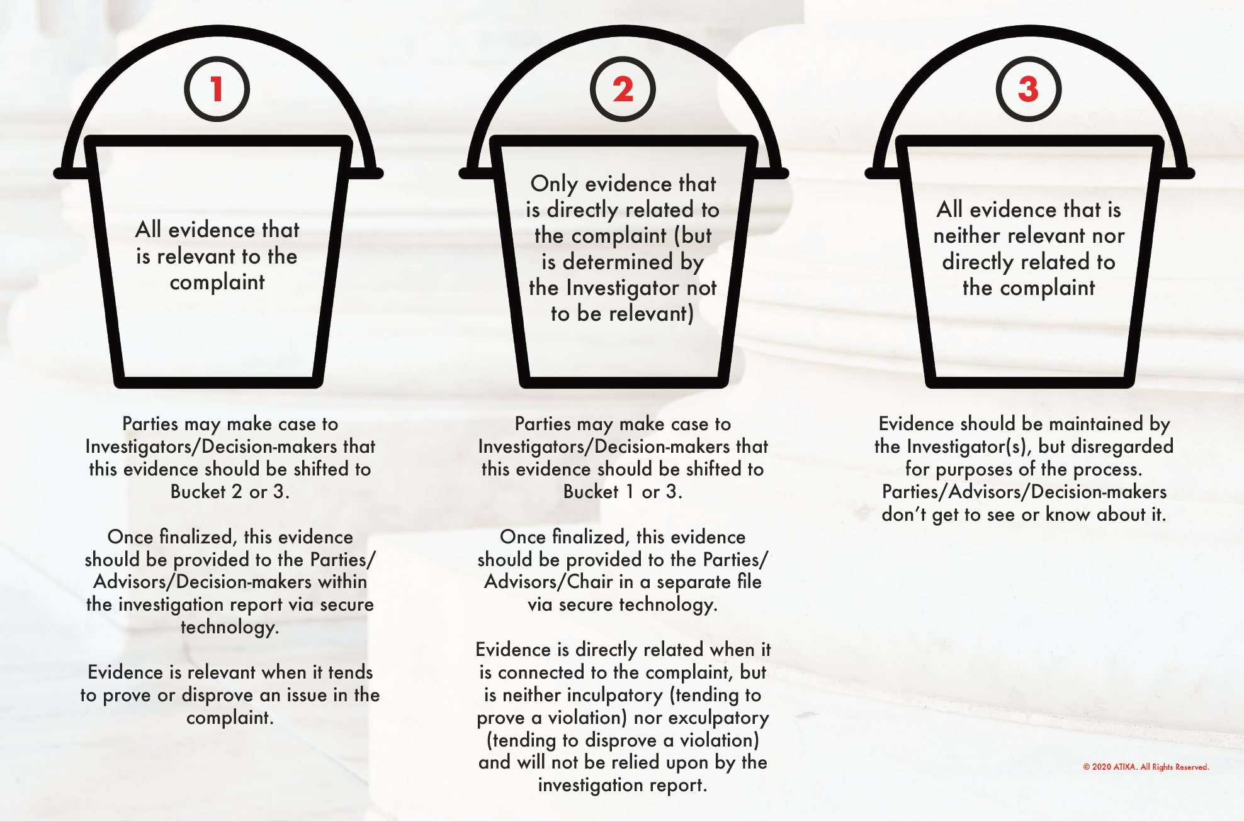
Buckets of Evidence

Slide 13
Credibility Assessment
Plausibility
Demeanor
Motive to Falsify
Corroboration
Past Record

Slide 14
Important Points
Document correspondence with involved parties
Script for initial meetings with parties
Take notes and record interviews
Create a timeline
Summarize party and witness statements and provide for review
Draft investigation report
Attorneys and Advisors
Resources are available in Teams

Slide 15
Issues That May Arise
Trauma-informed response
Acknowledging and remedying bias
Disclosure of additional sexual misconduct
Accessibility
Advisors / Attorneys

Slide 16
Questions?

