Slide 1
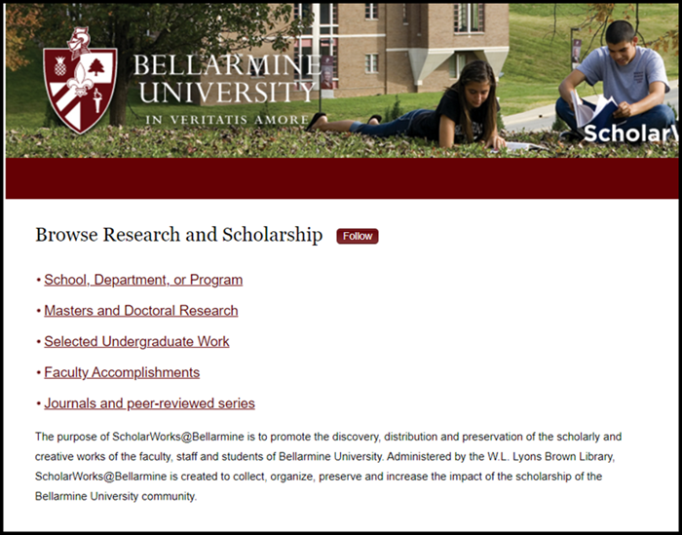
Submitting Your Thesis or
Dissertation to ScholarWorks
First, follow these instructions to format your document:
After formatting your document, return to this
guide to continue the submission process. For a video version of these instructions, please click here

Slide 2

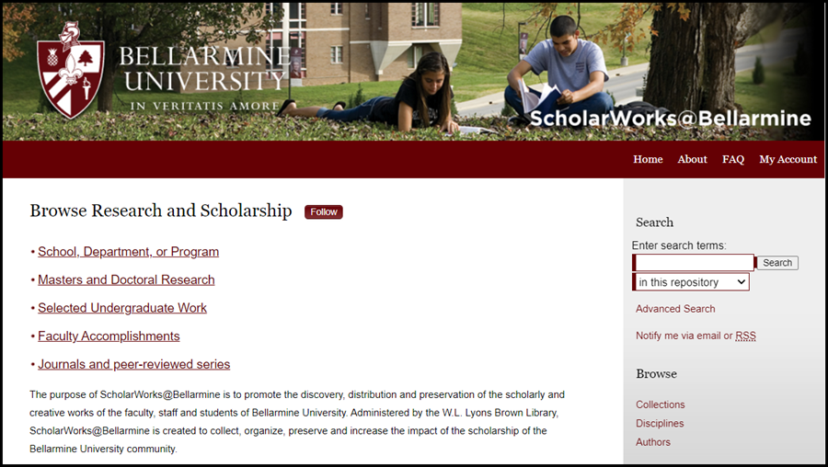
Begin by going to the ScholarWorks home page
http://scholarworks.bellarmine.edu
You might want to print a copy of these instructions to help guide you through the process
Select
“My Account”

Slide 3
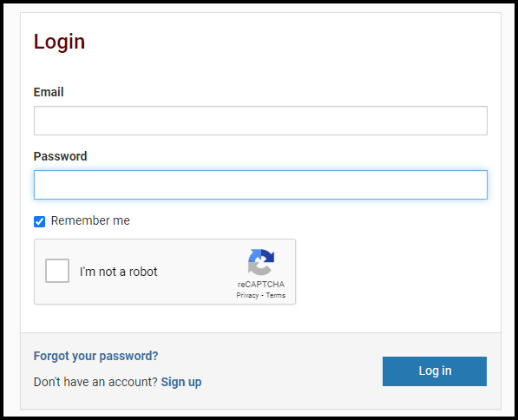
Sign up for an account

Slide 4
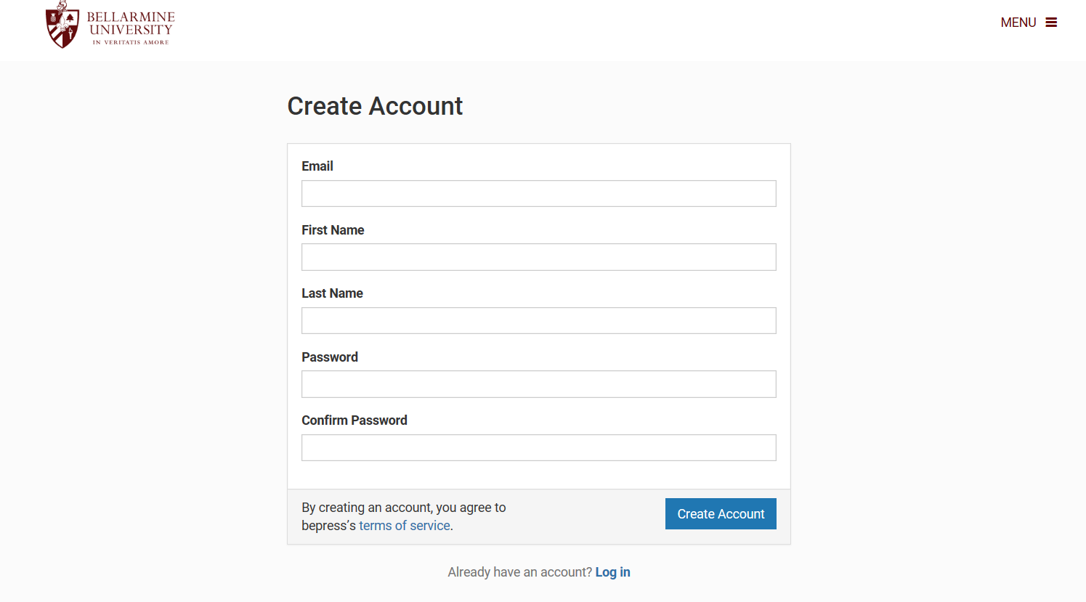
You do not have to use your BU email account but can if you want to. Students usually enter the email address they will use after graduation. The password does not have to be your BU account password. You can make up any password you choose…
Click “Create Account”

Slide 5
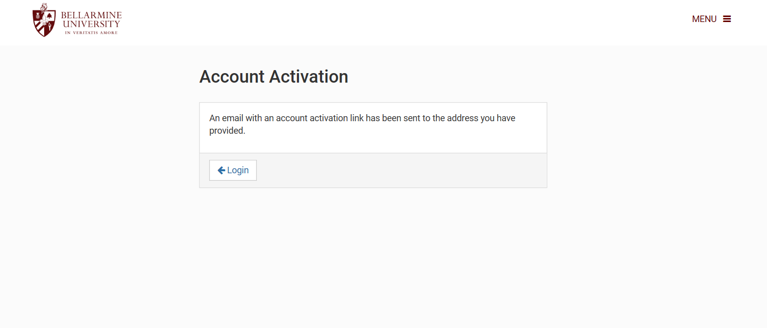
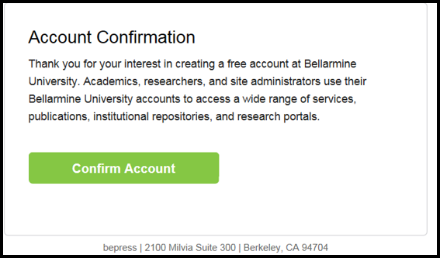

Slide 6
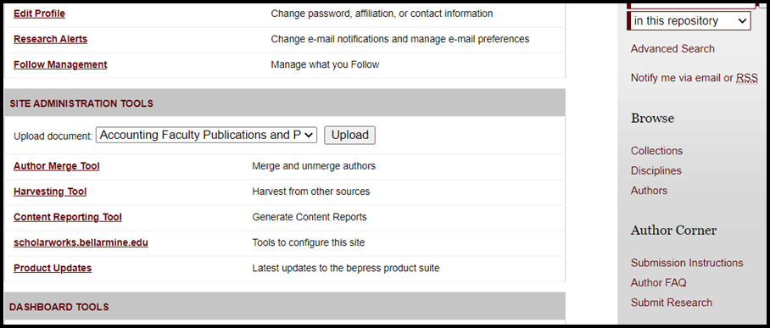
Select “Submit Research”

Slide 7
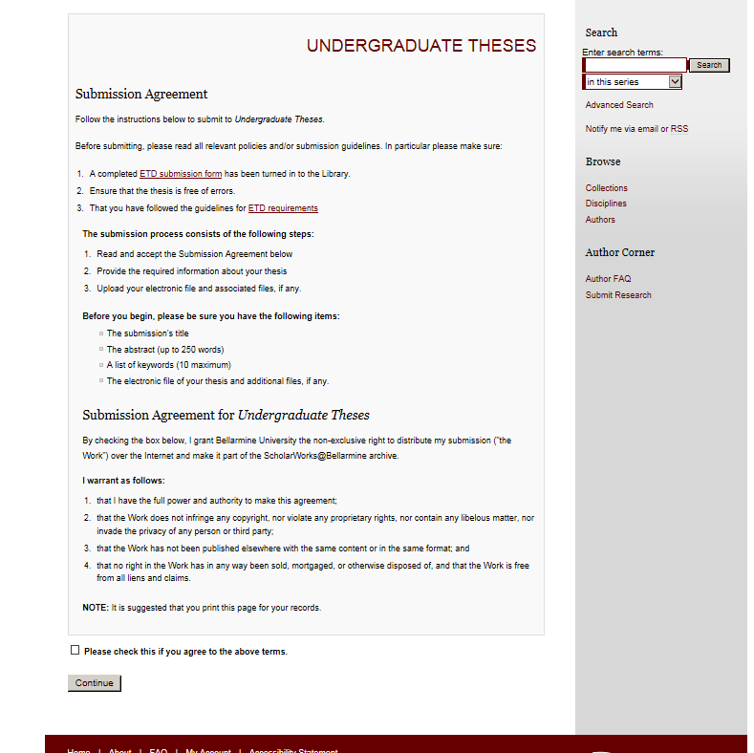
Read and understand the Submission Agreement before continuing
continuing

Slide 8
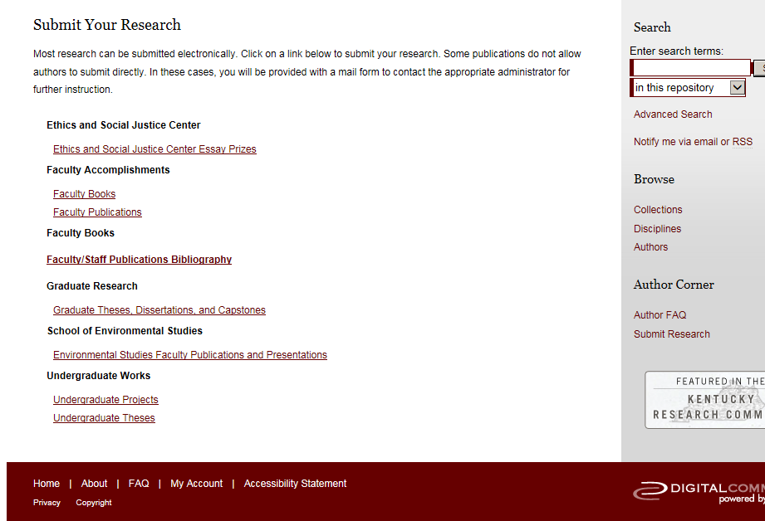




Click the Undergraduate Theses link
Choose the appropriate document category graduate…
…or undergraduate

Slide 9
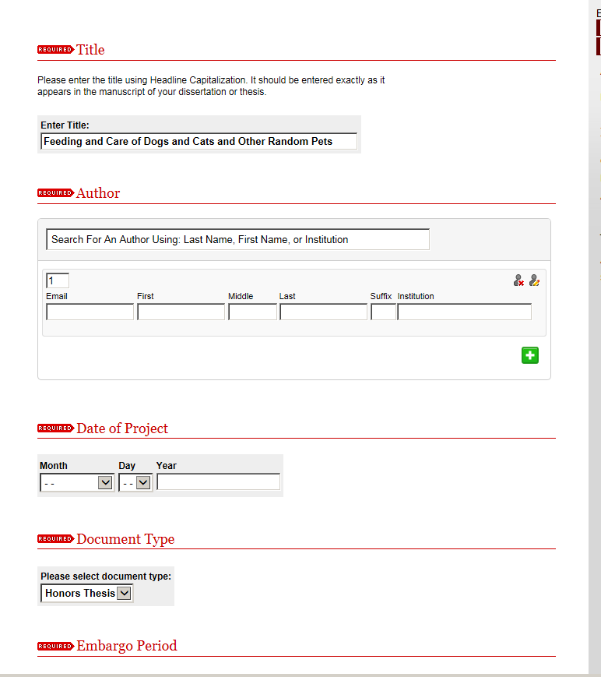
Enter your title in the format shown. Not all caps.
An embargo (delaying the posting of your document) can be added if you are considering publishing your document to a journal. The options are 6 mos.-1 year

Slide 10
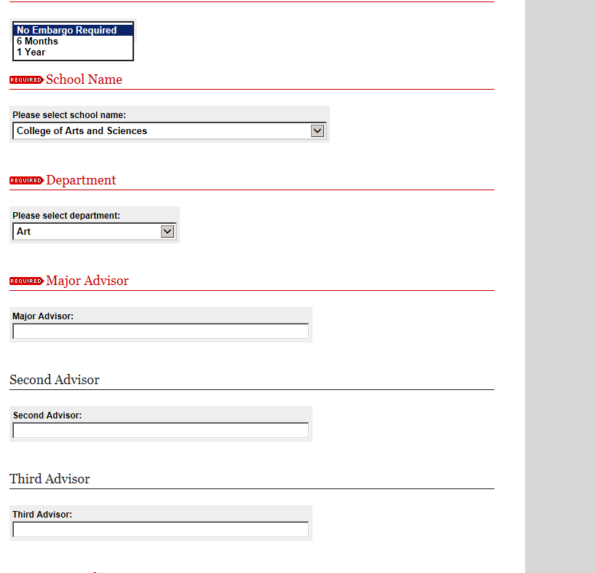
Consult with your thesis advisor about whether you should place an embargo on your document

Slide 11
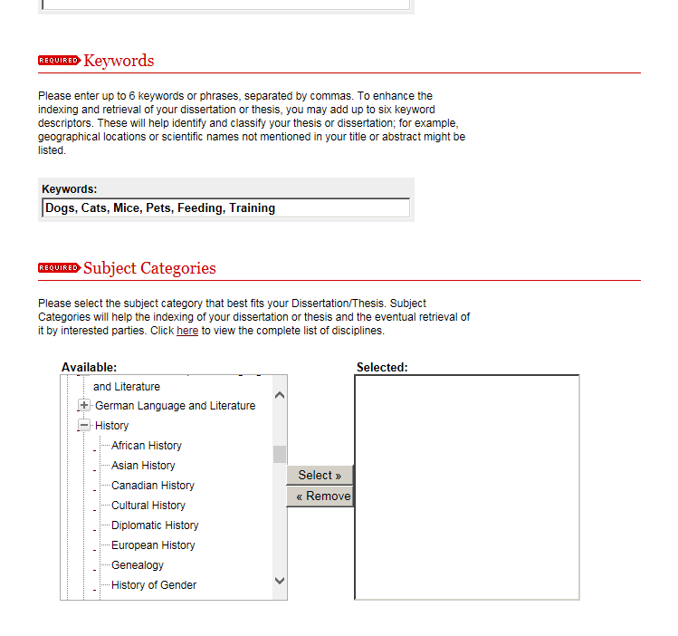
Add keywords and subject categories that best describe the content of your document. This will aid others who might be interested in finding your thesis

Slide 12
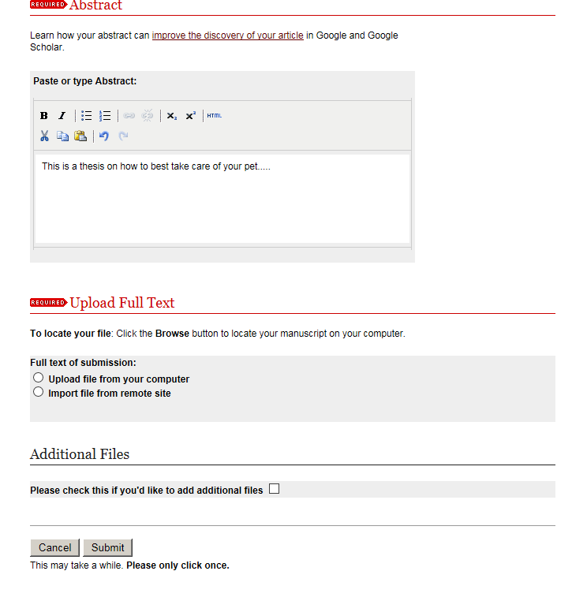




Enter a complete abstract for your document
Upload your document and click “Submit”

Slide 13
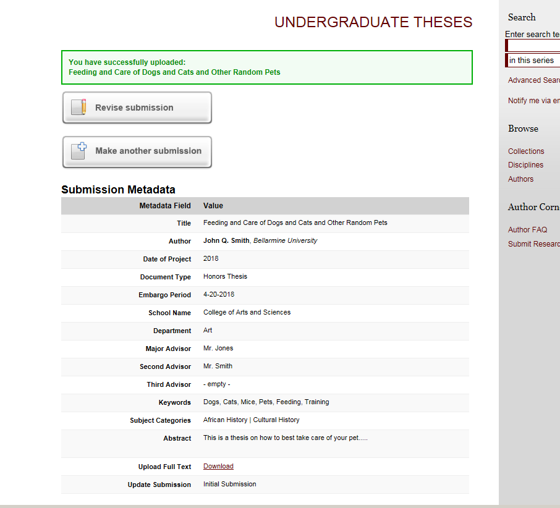
You should see a screen, like the one shown here, that includes the information you entered for your document

Slide 14
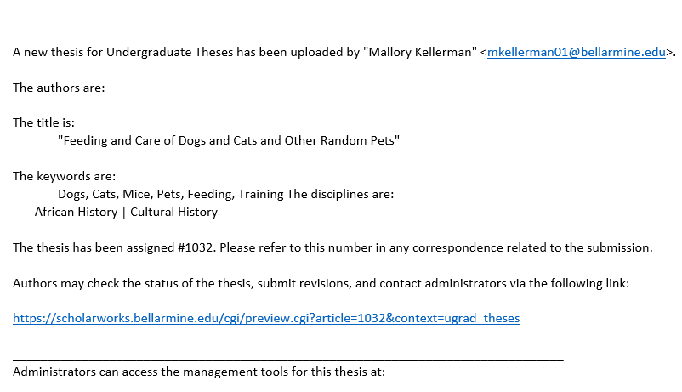
You will receive an email message like this which confirms that your submission has been sent

Slide 15
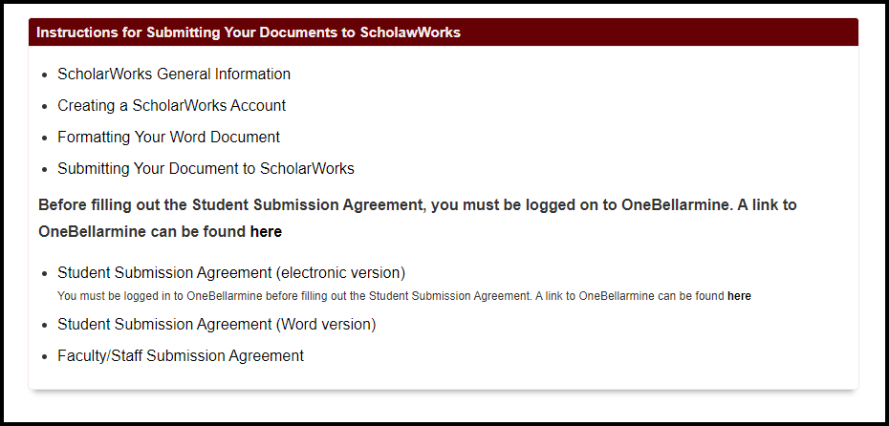
Next, you will need to sign the Student Submission Agreement.
You will need to logon to OneBellarmine
https://one.bellarmine.edu/
Once you have logged on to OneBellarmine, return to the submission
instruction page and fill out the Student Submission Agreement
https://libguides.bellarmine.edu/ScholarWorks_instructions_2

Slide 16
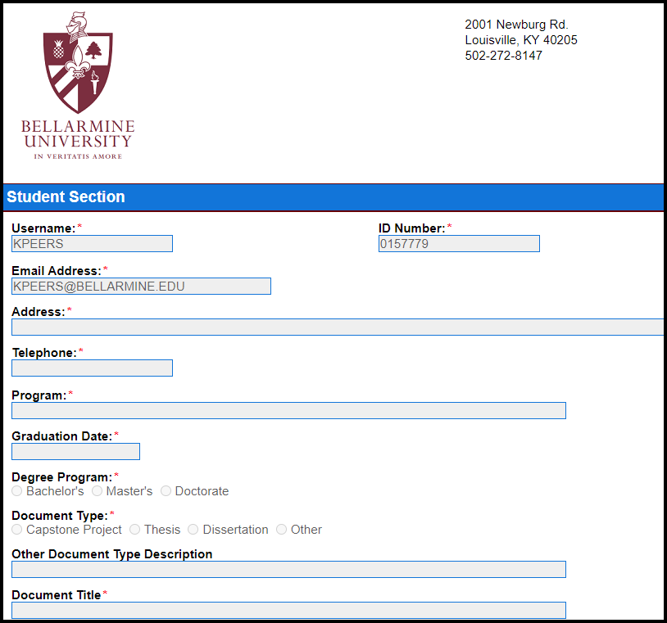
Fill out the student section of the form

Slide 17
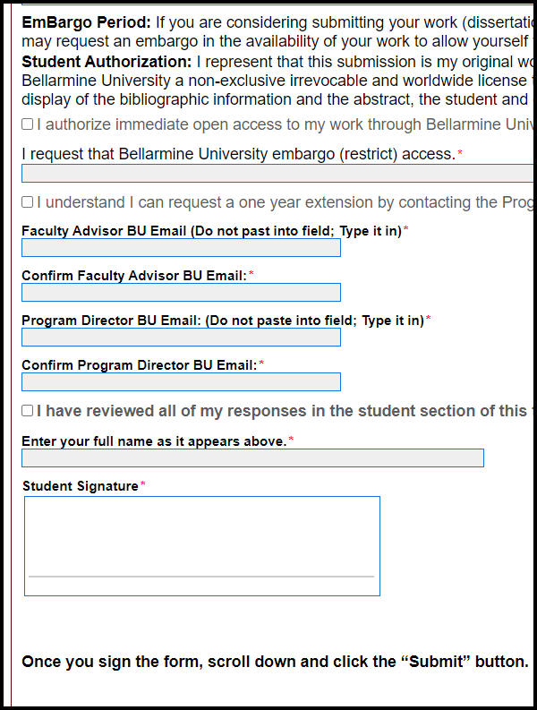
Enter the names and email addresses of your primary advisor and the program director
Sign the form
Scroll all the way to the bottom of the form and click on the “Submit" button

Slide 18
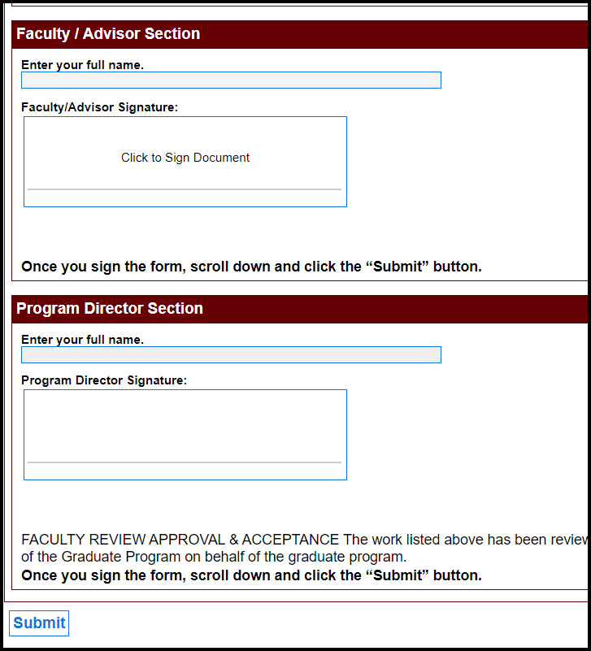

When you click the “Submit” button, the form will be automatically forwarded to your advisor and the program director for their signatures
If you have any questions about submitting your document to ScholarWorks, please contact one of the following:
Kevin Peers
kpeers@bellarmine.edu
502-272-8315
John Stemmer
jstemmer@bellarmine.edu
502-272-8140
Here is the “Submit” button. After that, you are done!
In a few days, you will receive an email indicating that your document has been posted to ScholarWorks

