Slide 1
Developing a Competitive Grant Proposal
Presentation for Bellarmine University
Maeve Connolly
Dr. Carol Burdsal
Tuesday, September 10, 2019
www.jm-aq.com

Slide 2
Common Misconceptions about Grantseeking
CRAFTING A COMPETITIVE PROPOSAL

Slide 3
Common Challenges
WHAT ARE SOME CHALLENGES?
A great idea/topic/area
But objectives and goals are not well defined and/or do not align with the goals/objectives of the grant
But not grounded in literature
But not sure it’s innovative/how it contributes to the knowledge base
Worked with your institutional strengths
But ignored weaknesses
Put together a good project
But the budget does not align

Slide 4
Research Question/ Area of Interest
STARTING THE PROCESS
Do you have a clearly defined research question or area of interest?
What is unique about your research (area of interest)?
How will this generate new knowledge in the field or fill a gap?
Notes:
Is the idea something no one else has tried?
Have you done a literature search?
Does it seem out of the ordinary?
Does your idea fill a gap?
Are you proposing a new technique in your teaching, or building on a proven practice using a new twist?
Keep a journal of your ideas and scholarly interests.
What questions do you have within your area of expertise?
What excites you about your chosen field?
What articles that you’ve read lately intrigue you?

Slide 5
STARTING THE PROCESS
What you’re really trying to do is...
SELL your good idea to a funding agency based on a critical need within their MISSION

Slide 6
Group Exercise: The Elevator Pitch
ELEVATOR PITCH
“brief persuasive speech that you use to spark interest in what you do”

Slide 7
The Elevator Pitch
ELEVATOR PITCH
No more than 2 minutes
It’s very brief commercial about your project
Goal = make the person you are addressing,
regardless of their background, understand:
the problem/question/issue that you are addressing,
why it is important, and
how your great idea will solve the problem that you have identified
(why you are the ideal person to solve the identified problem)

Slide 8
Elevator Speech Examples
ELEVATOR PITCH
Bad Elevator Speech – Carol’s research
Good Elevator Speech – Carol’s research

Slide 9
Please construct your very own elevator speech
ELEVATOR PITCH
Got it!

Slide 10
The Elevator Pitch
ELEVATOR PITCH
Construct a 2 minute summary of your planned research project and be prepared to present it to this audience
You may include in your elevator pitch:
The general problem/question/critical need or gap that you are addressing
The significance of the question that you are addressing
Your planned study (your rationale/hypothesis/specific aims)
Your approach/innovation
Your qualifications for this project
The impact of your work

Slide 11
Developing a Plan (Think Big, Start Small)
DEVELOPING A PLAN
Year One
Year Two
Year Three
Year Four
Year Five
What prelim data do I need for my research?
What will it take to get it – lab space, students, etc.
Where will I get seed money?
What mentors/partners will help me with this?
What grants have I received?
What are my major project goals?
What strategic collaborations should I have?
What impact has my research made?
What/how much have I published and where?
What am I known for?
Notes:
How many people have a five year plan? How many people have a clear vision for their research?
If so, do you want to share your experiences? Power of a good idea will propel you.

Slide 12
Developing a Plan Cont’d
DEVELOPING A PLAN
Notes:
think a little more linearly using backwards design to help you narrow down your focus area/areas.
Good example Is like travel planning
Build a wise itinerary using a map.
So it is with program or curriculum design. Program goals should be determined first, before activities planned.

Slide 13
Identifying Opportunities
GRANT STRATEGY
Contact Maeve and McAllister & Quinn
Bring your concept paper and come prepared to discuss your long-term research goals and current project idea(s)
Resources (search by key words, awardees, topic areas, etc.):
Grants.gov
Listservs
Professional societies
Research previous recipients and funding priorities
Complete a concept paper and inquire about internal funding approvals

Slide 14
Start Early
GRANT STRATEGY
Ask questions and know your literature
Evaluator for institutional grants
Strictly follow the guidelines
Reach out to the agency or foundation
Register with the agency/organization to access the application
Clarify the roles and expectations with the team

Slide 15
Engaging with a Grant Proposal Concept
GRANT STRATEGY
Determining where your research fits at the agency
Finding the appropriate person to contact at the agency
Crafting your concept paper
How to reach out to the PO

Slide 16
Get your idea vetted = Talk to a PO
GRANT STRATEGY
If the core idea is not likely to be funded, the PO can reduce the office workload by discouraging the submission
If the core idea would fit better with a different Directorate/cluster or Institute/Center (i.e. different funding portfolio), the program officer may redirect you to a colleague
If the PO finds the idea intriguing, s/he might provide helpful hints on how to shape the proposal in ways that will result in a more positive review

Slide 17
FUNDING

Slide 18
Before you submit – Talk to a Program Officer
If the core concept/idea is undeveloped, the PO let you know
If the project would fit or review better in a different Program or Institute/Center, the PO may redirect you to a colleague
If the PO finds the idea intriguing, s/he might provide helpful hints on shaping the proposal in ways that will result in a more positive review

Slide 19
The Concept Paper
A brief 1- page document used:
to structure a funding request
to communicate with the PO
In general you will communicate:
Introduction (The Big Question)
Why the project is important (significant and impactful)
Brief project description (goals, objectives, & activities)

Slide 20
Concept Paper Template
What do you what to do? What is the Big Question that you will be addressing?
Why is the question/project important? What is the significance of your project?
How will you answer your question? Briefly describe your project.
Who will carry out the project and why are they suited for this work?
How will undergraduates be involved in this project? If sending to NSF, describe all the Broader Impacts.

Slide 21
Sharing Your Concept Paper with a (PO)
Send Introductory email
Include Concept Paper (1-pager) as attachment or pasted in body of the email
Best practice = ask the PO for feedback on the “fit” of proposal for their competition

Slide 22
Sample PO Email
Dear <Dr. PO NAME>,
I am a/an Asst/Assoc/Professor of <YOUR DEPARTMENT> at <YOUR INSTITUTION> and I am preparing a submission for the upcoming <PROGRAM/SOLICITATION NAME> competition. I have attached a brief description of my planned project and would greatly appreciate your feedback on the fit for your program.
I would like to set up a call to discuss your feedback and would of course make myself available at your convenience.
Thank you in advance for your time and advice,
<YOUR NAME>

Slide 23
Responding/Revising After PO Feedback
POs will be very definitive if your project is NOT a fit
If your project is a fit, they will NOT tell you how competitive your idea is
They will give you pointers/hints on red flags
PAY ATTENTION to these hints and restructure your submission accordingly

Slide 24
Writing and Submitting a Grant
WRITING AND SUBMITTING A GRANT
Writing
Write to the goals and interests of the organization/agency
Follow the guidelines and structure provided
Provide only what is asked
Create a project timeline
Submission
Make sure the application goes through the proper internal approvals prior to submission
Submit early, ALWAYS
Coordinate reports internally
Notes:
Is it well written? “Think like a wise man, but communicate in the language of the people.”

Slide 25
The Waiting Game
WRITING AND SUBMITTING A GRANT
Proposal review process
What should I be doing while I wait to hear about the grant?
Agency Stats:
It takes on average 2.4 tries before receiving first NSF award
NSF received 48,000 applications and funded 21%.
NIH received 51,000 applications and funded 8-26%
NEH received 4,400 applications and funded between 10-20%
Half of funded research proposals submitted to Federal agencies
are resubmissions of previously rejected proposals
Notes:
Want a diverse group of project that creates new knowledge and breakthroughs in understanding across all STEM disciplines.
Make every effort to conduct a fair, competitive, transparent merit review process for selection of project.
Your peers in the field: scientists, engineers, educators and field experts
Approximately 50,000 scientists and engineers each year to assist the NSF
3-6 reviews, outside NSF, serve as ad hoc reviewers and panelists
Reviewers chosen for diverse and specialized knowledge of science or engineering fields and subfields

Slide 26
Declination is Part of the Game
GRANT STRATEGY
WRITING AND SUBMITTING A GRANT
Review Feedback
Agencies rarely fund on the first submission
Feedback improves the draft
Carefully read the review summary and comments
Revise and Resubmit
Schedule a call with your M&Q Director to discuss next steps, such as reworking the proposal and coordinating a call with the cognizant PO
RESUBMIT!

Slide 27
Best Practices
IN SUMMARY
Do your homework
Match the funding agencies mission
Read the solicitation and previously funded proposals (FOIAs)
Write to the goals and objectives of the grant not to the idea you think they will fund
Have your elevator pitch handy
Start early
Literature review to identify gaps
Gather baseline data
Identify the team and communicate frequently
Focus on one or two areas and have a hook
Write to the review criteria

Slide 28
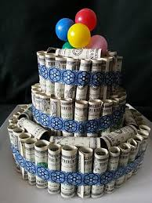
Best Practices Cont’d
IN SUMMARY
Good ideas→ Grant writing→ Enhanced scholarship and professional development→ Funding
Do not get discouraged! Getting started early, learning from declined proposals, and networking with colleagues at peer institutions and conferences will help you stay on track to reach your goal.

Slide 29
Becoming a Reviewer at NSF
BECOMING A REVIEWER

Slide 30
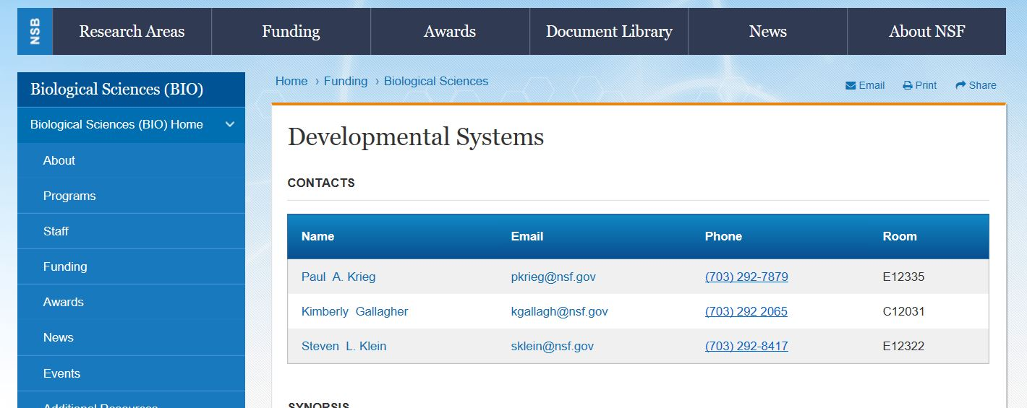
Email to Appropriate PO
EMAILING THE PO
Introduce your self and your research focus
Attach CV
Mention any previous funding or NSF panel experience

