Slide 1
Working with M&Q and your Grants Office
Presentation for Bellarmine University
Maeve Connolly
Dr. Carol Burdsal
Tuesday, September 10, 2019
www.jm-aq.com

Slide 2
Who We Are
ABOUT US
Washington, DC-based consulting firm
Founded in 2004.
Specialize in securing funding for a wide range of organizations.
Team of grants experts
Over 45 staff from Congressional and Executive branches, Academia, non-profit sector, and industry.
250+ content-specific grant writers.

Slide 3
Discussion Topics
TODAY’S PRESENTATION GOALS
Working with McAllister & Quinn (M&Q)
M&Q Process
Federal Grants
Navigating the Foundation World

Slide 4
Working with McAllister & Quinn
GOALS
Our Goals
Strengthen and support the work that Bellarmine’s grants office does to support faculty research and cultivate a robust grants culture on campus
Strategic advice that will position the institution for the highest chance of success

Slide 5
The M&Q Process
PROCESS
Four Federal grants per year
Writing
Additional services
Coaching opportunities for faculty
Concept Paper Templates or Prep Materials
Review Concept Papers & Assist with PO Outreach
Advanced Notification on Grant Updates and Program Changes
Analysis of Annual Federal Budget
Faculty Development
M&Q Workshops & Webinars

Slide 6
The M&Q Process Cont’d
PROCESS

Slide 7
The M&Q Process Cont’d
PROCESS
Preparation (4 months before grant deadline)
Meetings with faculty to review solicitation requirements, memo, RFP, and grant ideas
Research.gov and Workspace registration
Begin Concept Paper
Call with Managing Director (and agency Program Officer when appropriate) to review Concept Paper
Revise Concept Paper and begin gathering required attachments (letters of support, budget, biosketches, etc.)
Process (45-60 days before grant deadline)
Expectations document outlining roles and responsibilities
Weekly check in calls
Internal Panel Review & copy edit

Slide 8
McAllister & Quinn Coaching, Review, and Edit Process
PROCESS
Project managed by Maeve/McAllister & Quinn and with BU Team
McAllister & Quinn Coach works weekly with PI
Internal Panel Review – by reviewer familiar with subject matter/discipline/grant program (3 weeks prior to due date)
Incorporate Reviewer’s comments
Professional Edit – grammar, font, margins, page length, requirements (3-4 days prior to due date)
Incorporate Professional Edits
Official submission by BU Team
coach

Slide 9
Federal Agency Budgets
AGENCY BUDGETS
Total FY 2019 Budget:
National Science Foundation : $8.075 billion, a $307.6 million increase over FY 2018 levels.
Health Resources and Services Administration : $7.016 billion, a $146.75 million increase over FY 2018 levels.
Department of Education : $74.97 billion, a $650 million increase over FY 2018 levels.
The Institute for Museums and Library Sciences : $242 million, a $2 million increase over FY 2018 levels.
National Endowment for the Humanities : $155 million, a $2.15 million increase from FY 2018 levels.
National Institutes for Health : $39.08 billion, a $2 billion increase over FY 2018 levels.

Slide 10
Matching the Agency Funding Mission
AGENCY FUNDING MISSIONS
Federal grants are a solution to:
Public policy problems
Societal concerns and goals
Vital research and innovation
Align project to the funding agency’s mission:
Provide an innovative idea that will generate new or contribute to a growing body of knowledge in the field

Slide 11
Grant Project Preparation
PROJECT PREPARATION
The most competitive proposals begin months in advance and are a result of…
Careful Review:
Most recent solicitation
Information on grant programs (who is funded?)
Previously funded proposals
Strategic Planning:
Include goals and objectives
Call with a program officer
Research and review relevant literature

Slide 12
Foundation Proposals
FOUNDATIONS
Similarities:
Start early: look at website, call foundation
Know mission/goals of foundation
Identify your goals and objectives/align those with the foundation
Designing a compelling and innovative project
Writing and editing process

Slide 13
Foundation Proposals Cont’d
FOUNDATIONS
Differences:
More amenable to “seed money” requests
Tell a compelling story
Relationships mean something
Mission can change without public notice
More room for creativity
Feedback on proposal varies

Slide 14
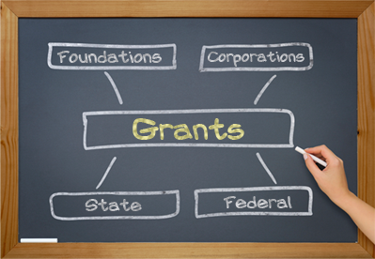

Slide 15
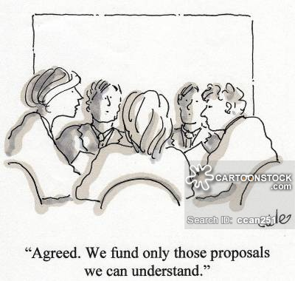
Write to the Goals and for the Reviewers
WRITING ADVICE

Slide 16
QUESTIONS

